Slide 1
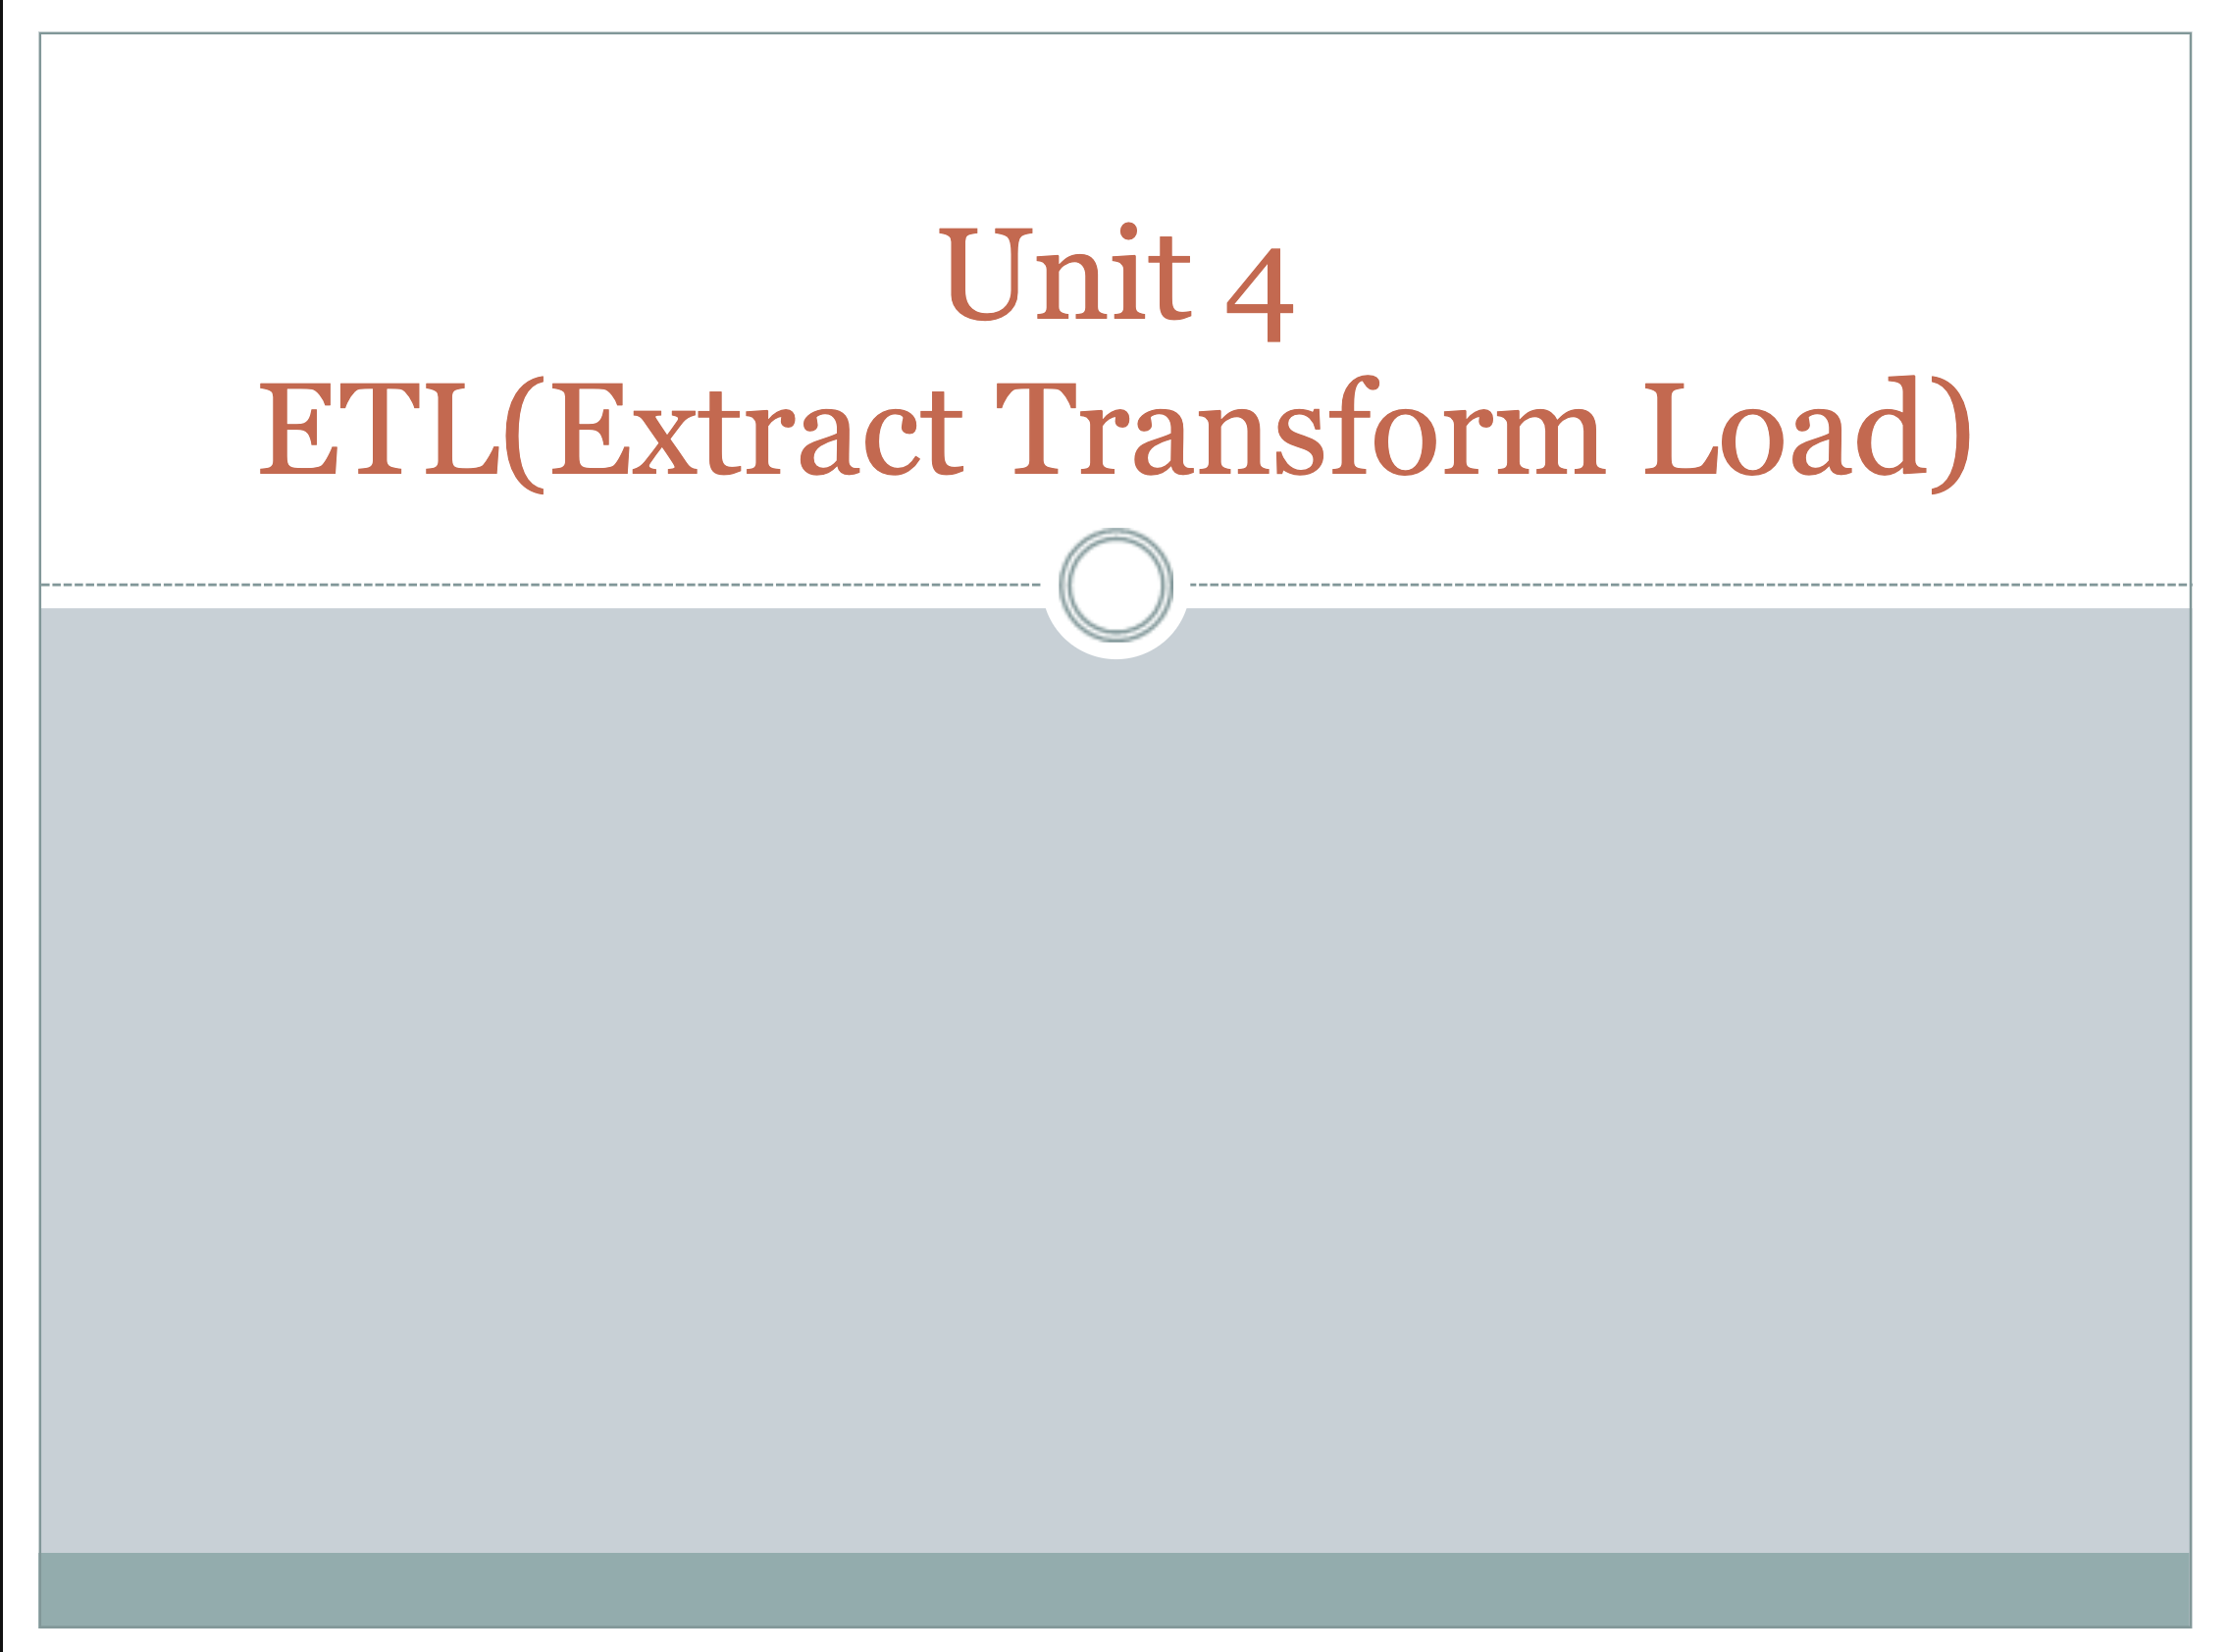

Slide 2
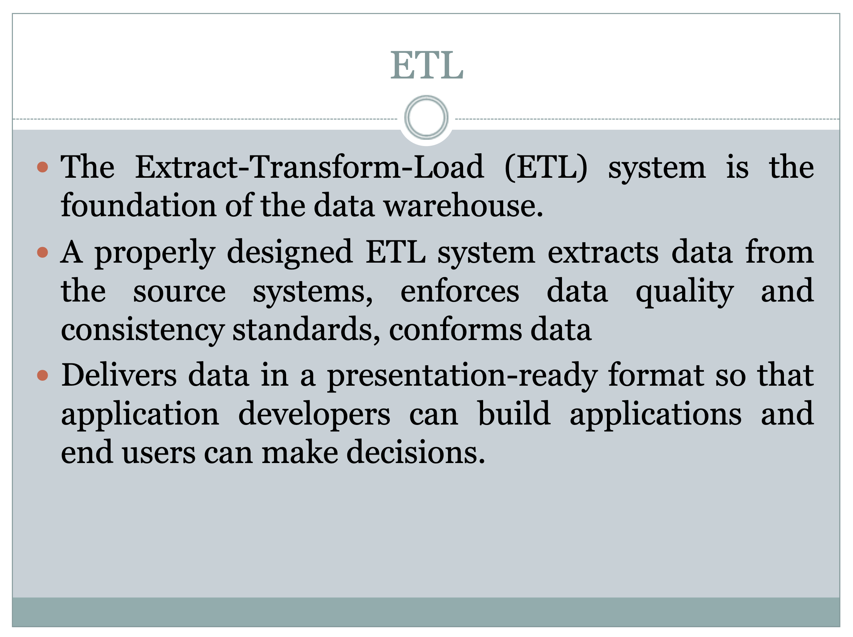

Slide 3
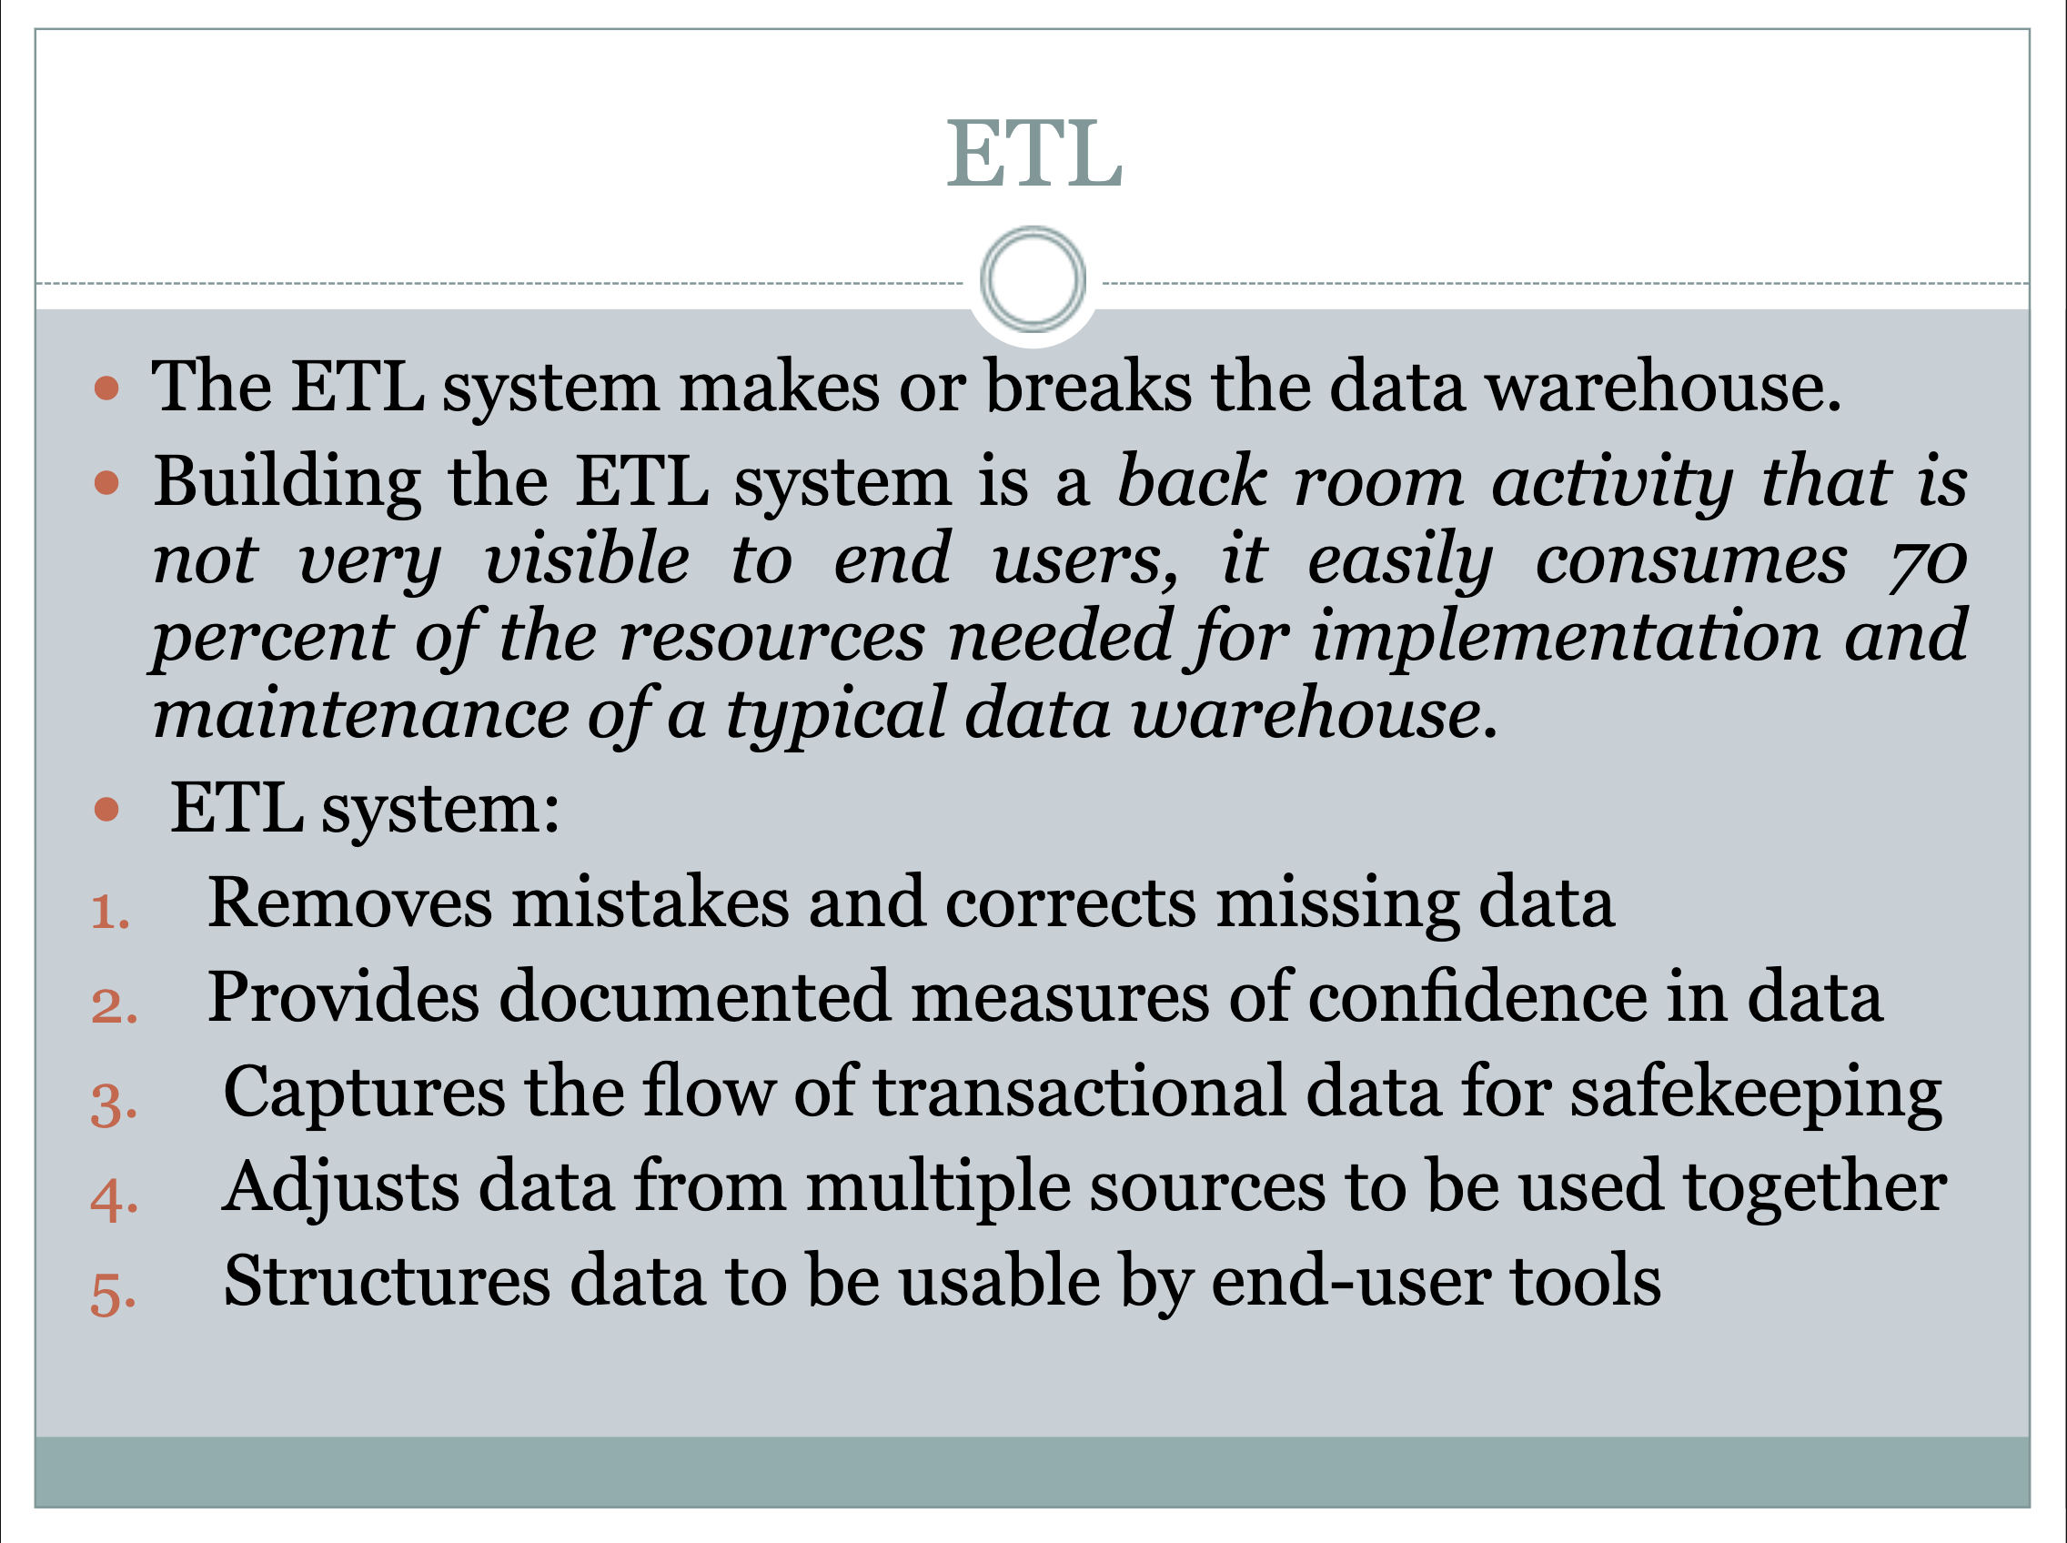

Slide 4
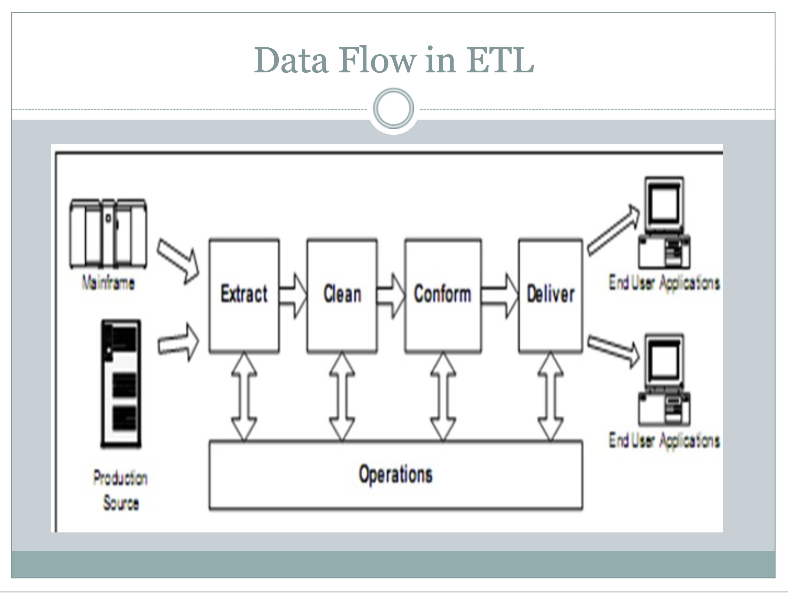

Slide 5
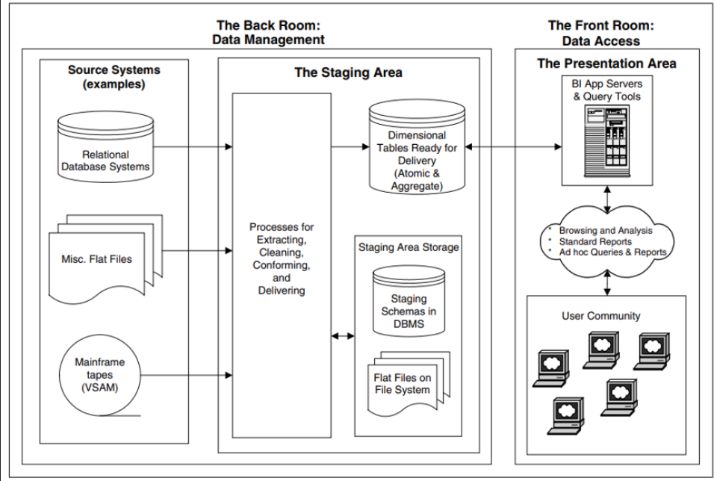
Back Room" focuses on the vital processes of data management that ensure high-quality data is prepared and ready for analysis, while the staging area serves as an essential step in the ETL pipeline that facilitates transformation and ensures data integrity before reaching the end users
staging area serves as an intermediate space where data is temporarily held during the ETL process before it moves to the final destination i.e. Datawarehouse.

Slide 6
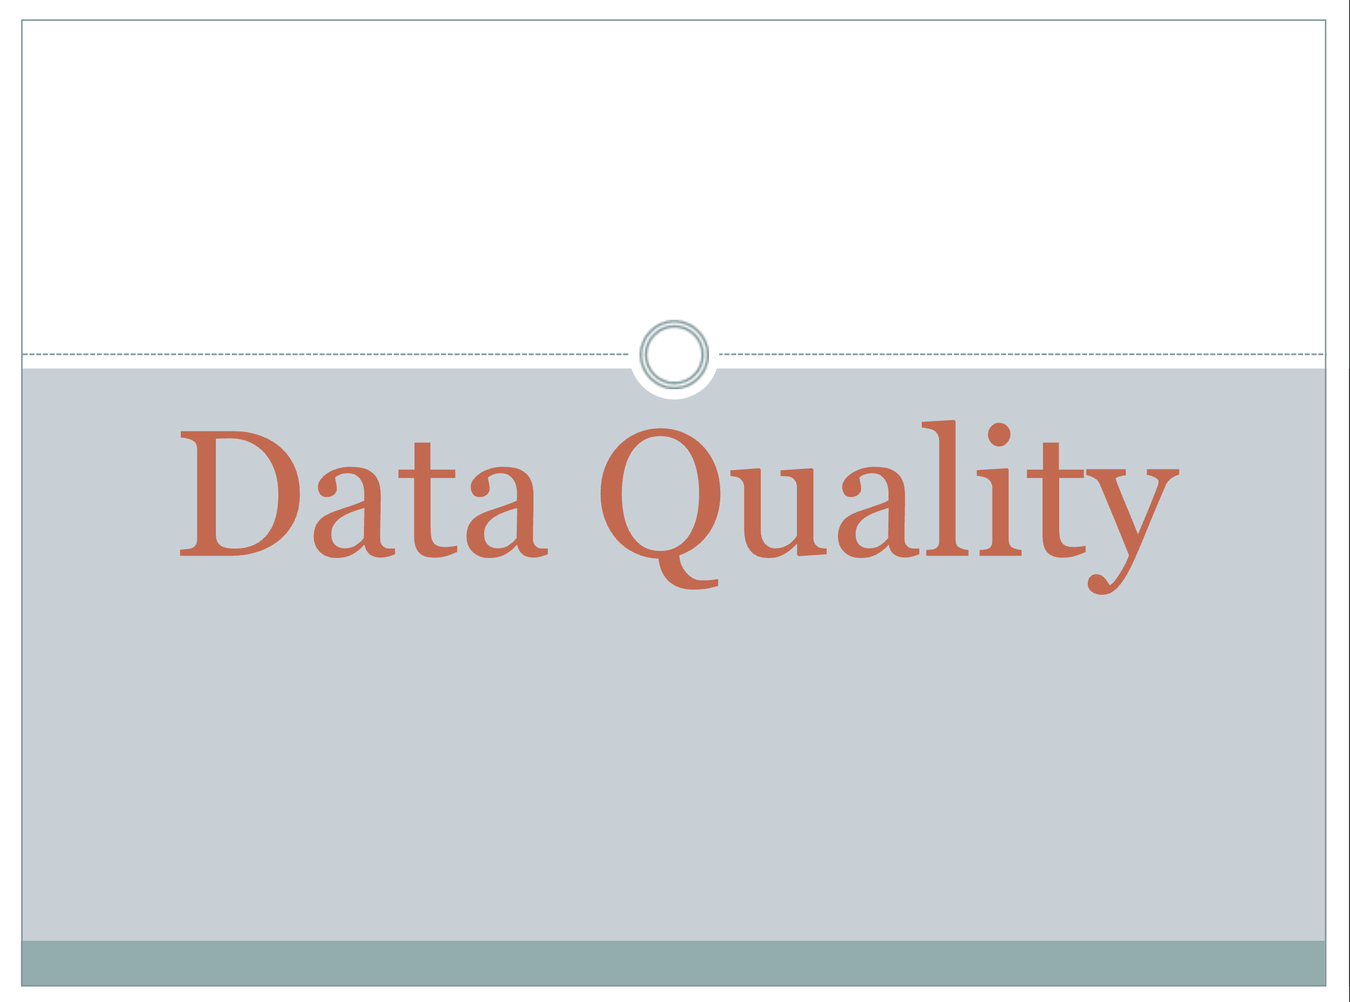

Slide 7
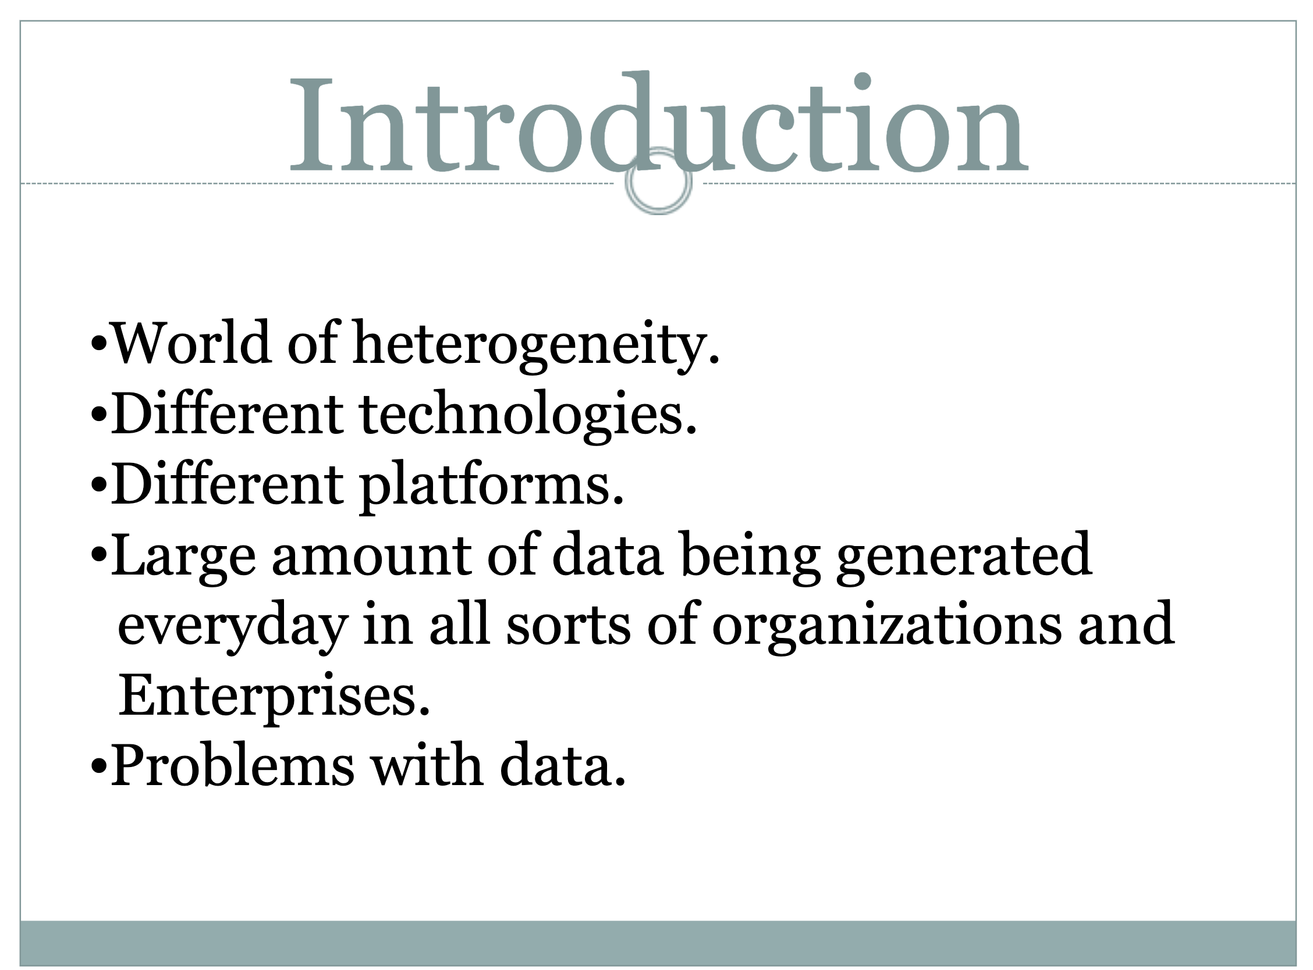

Slide 8
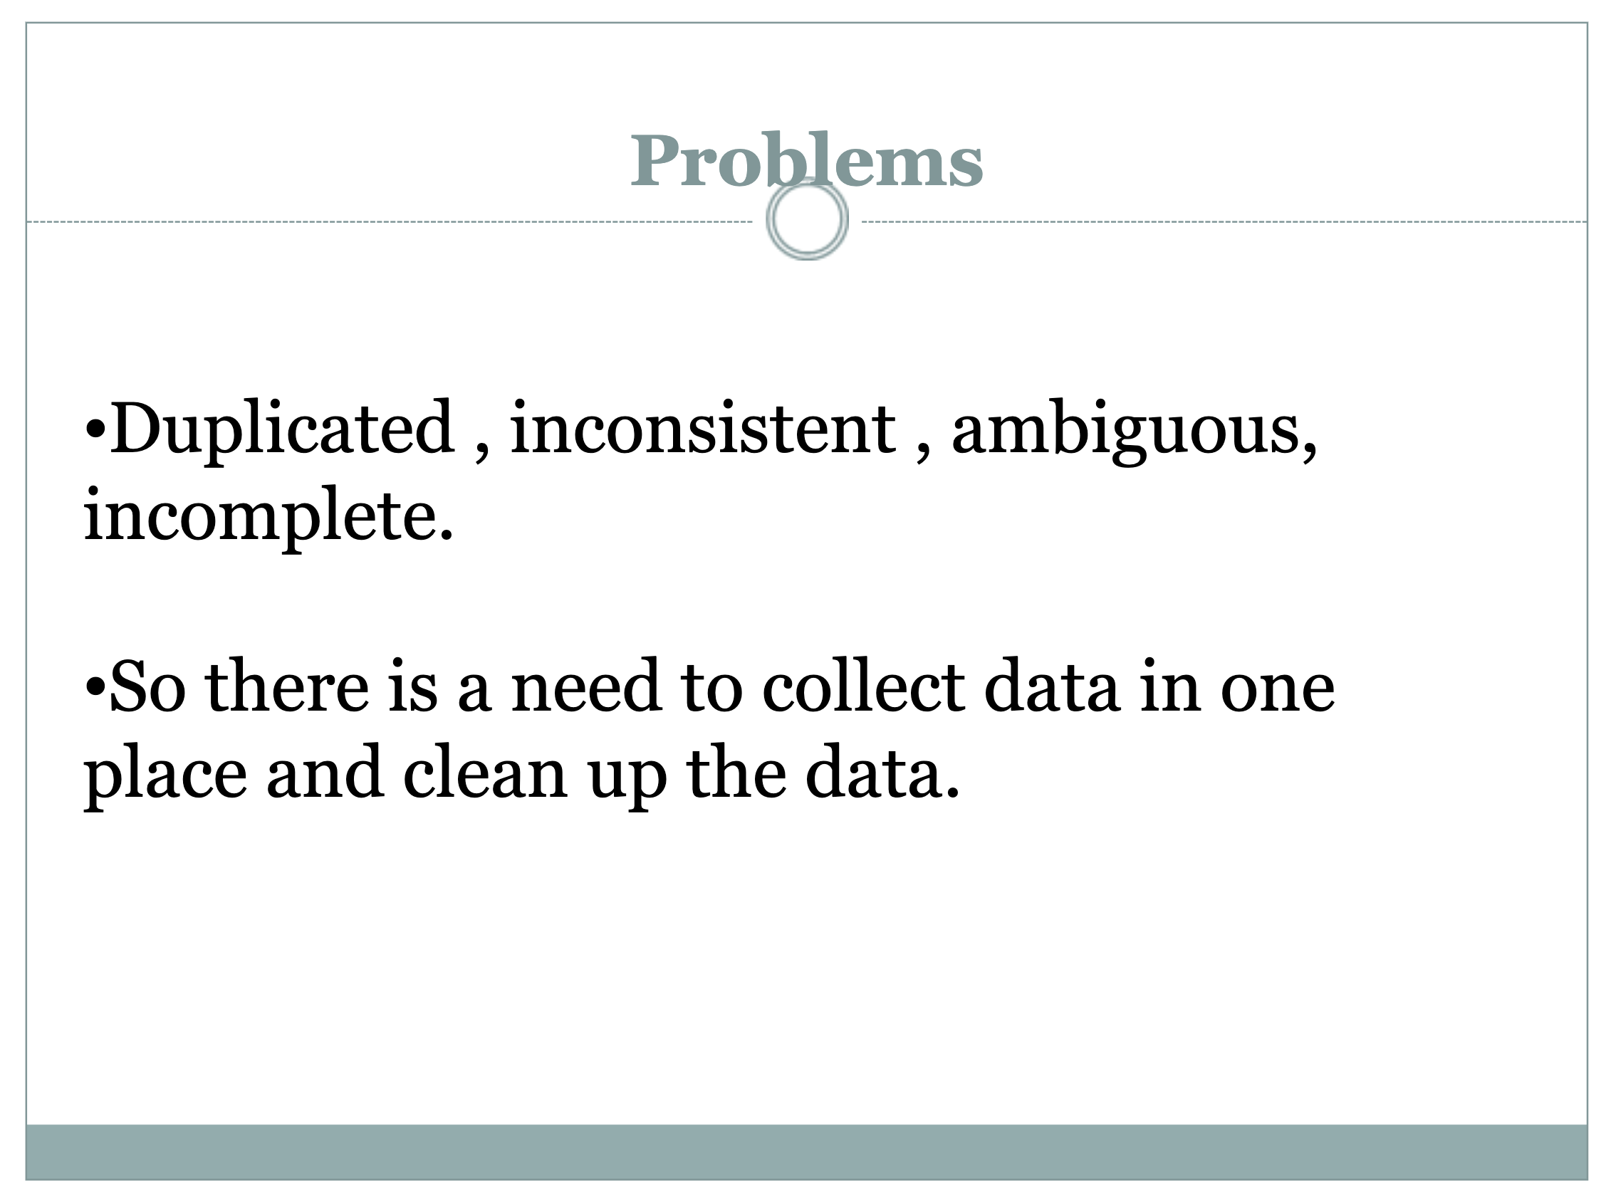

Slide 9


Slide 10
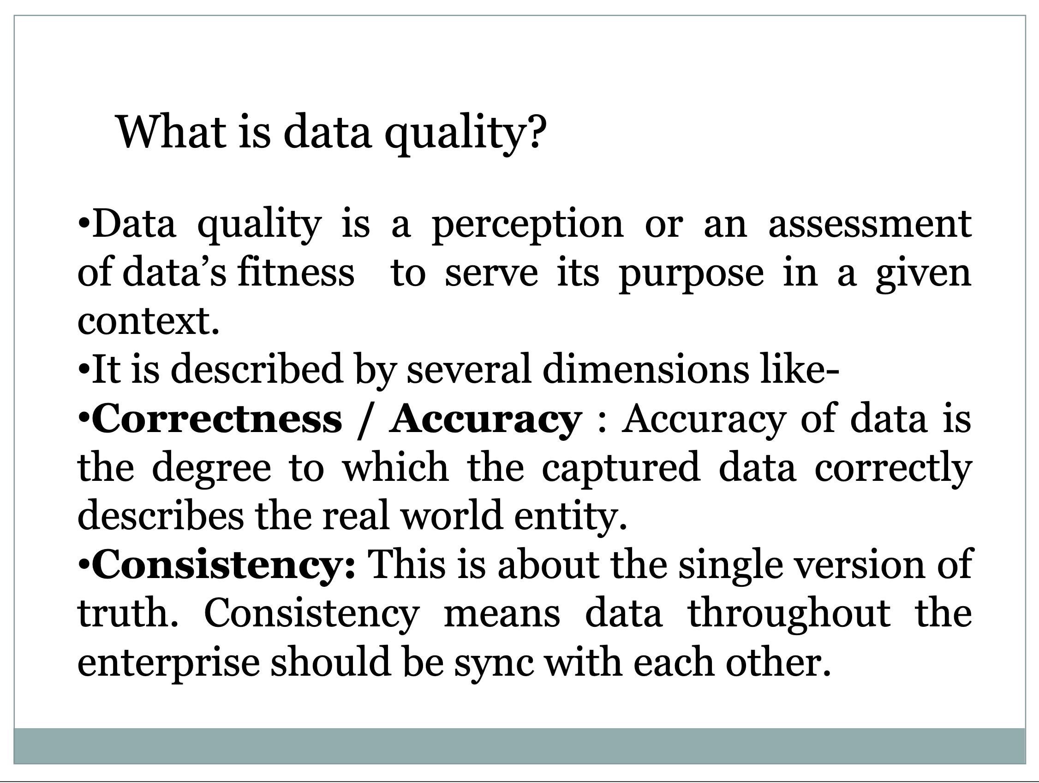

Slide 11
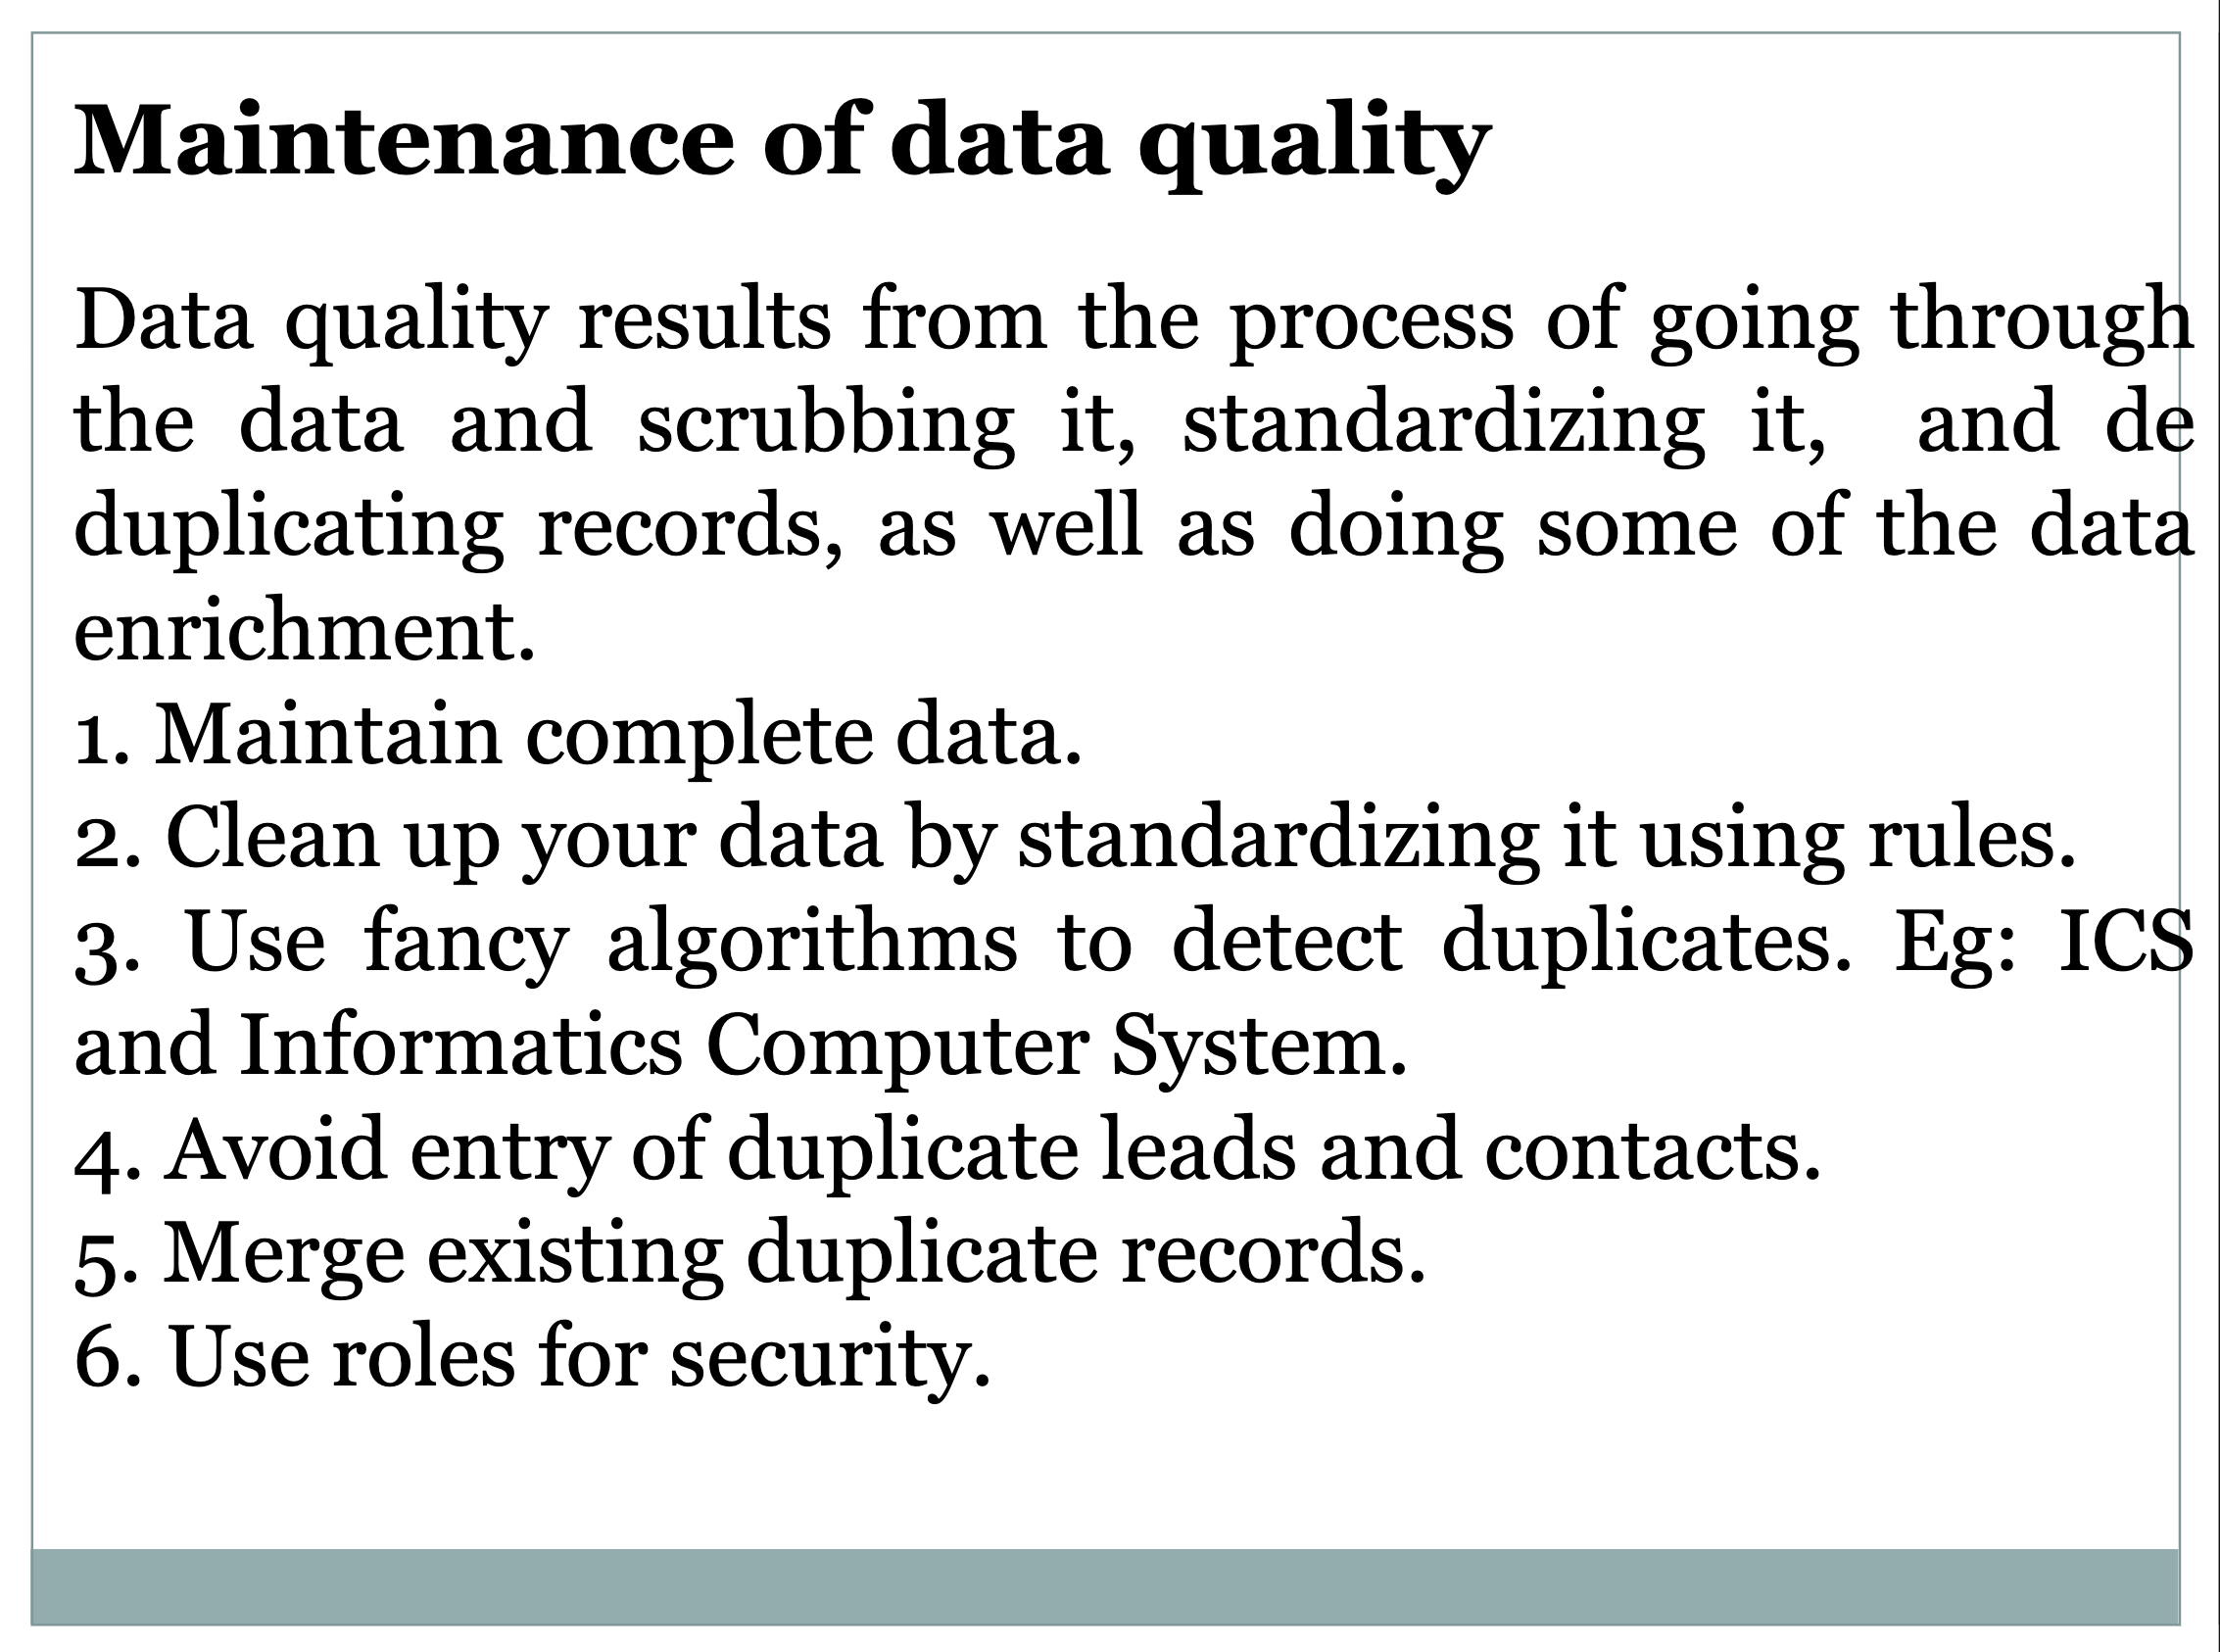

Slide 12
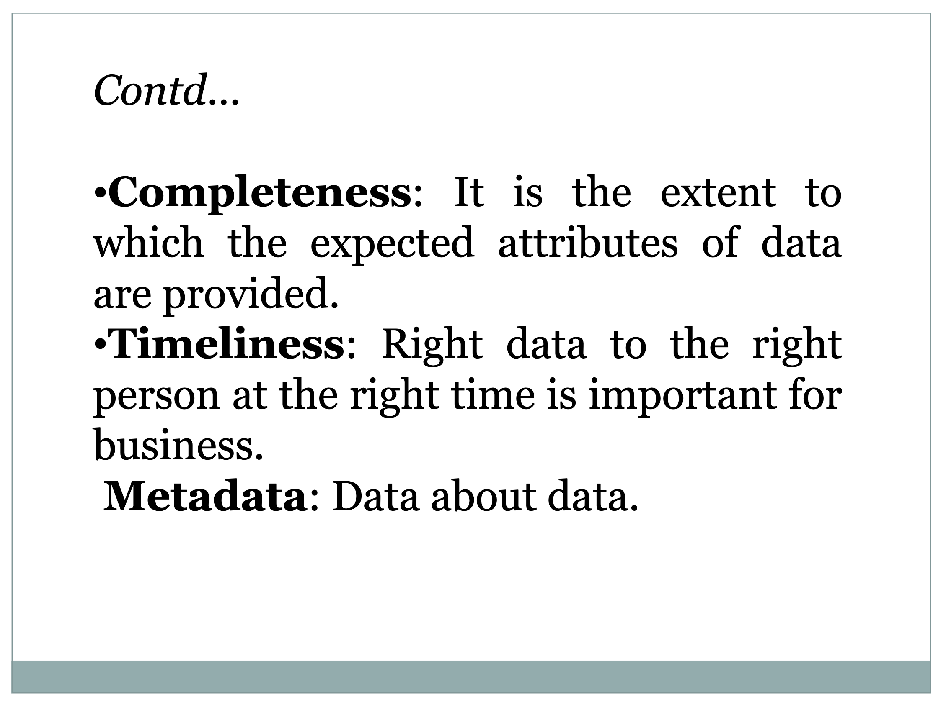

Slide 13
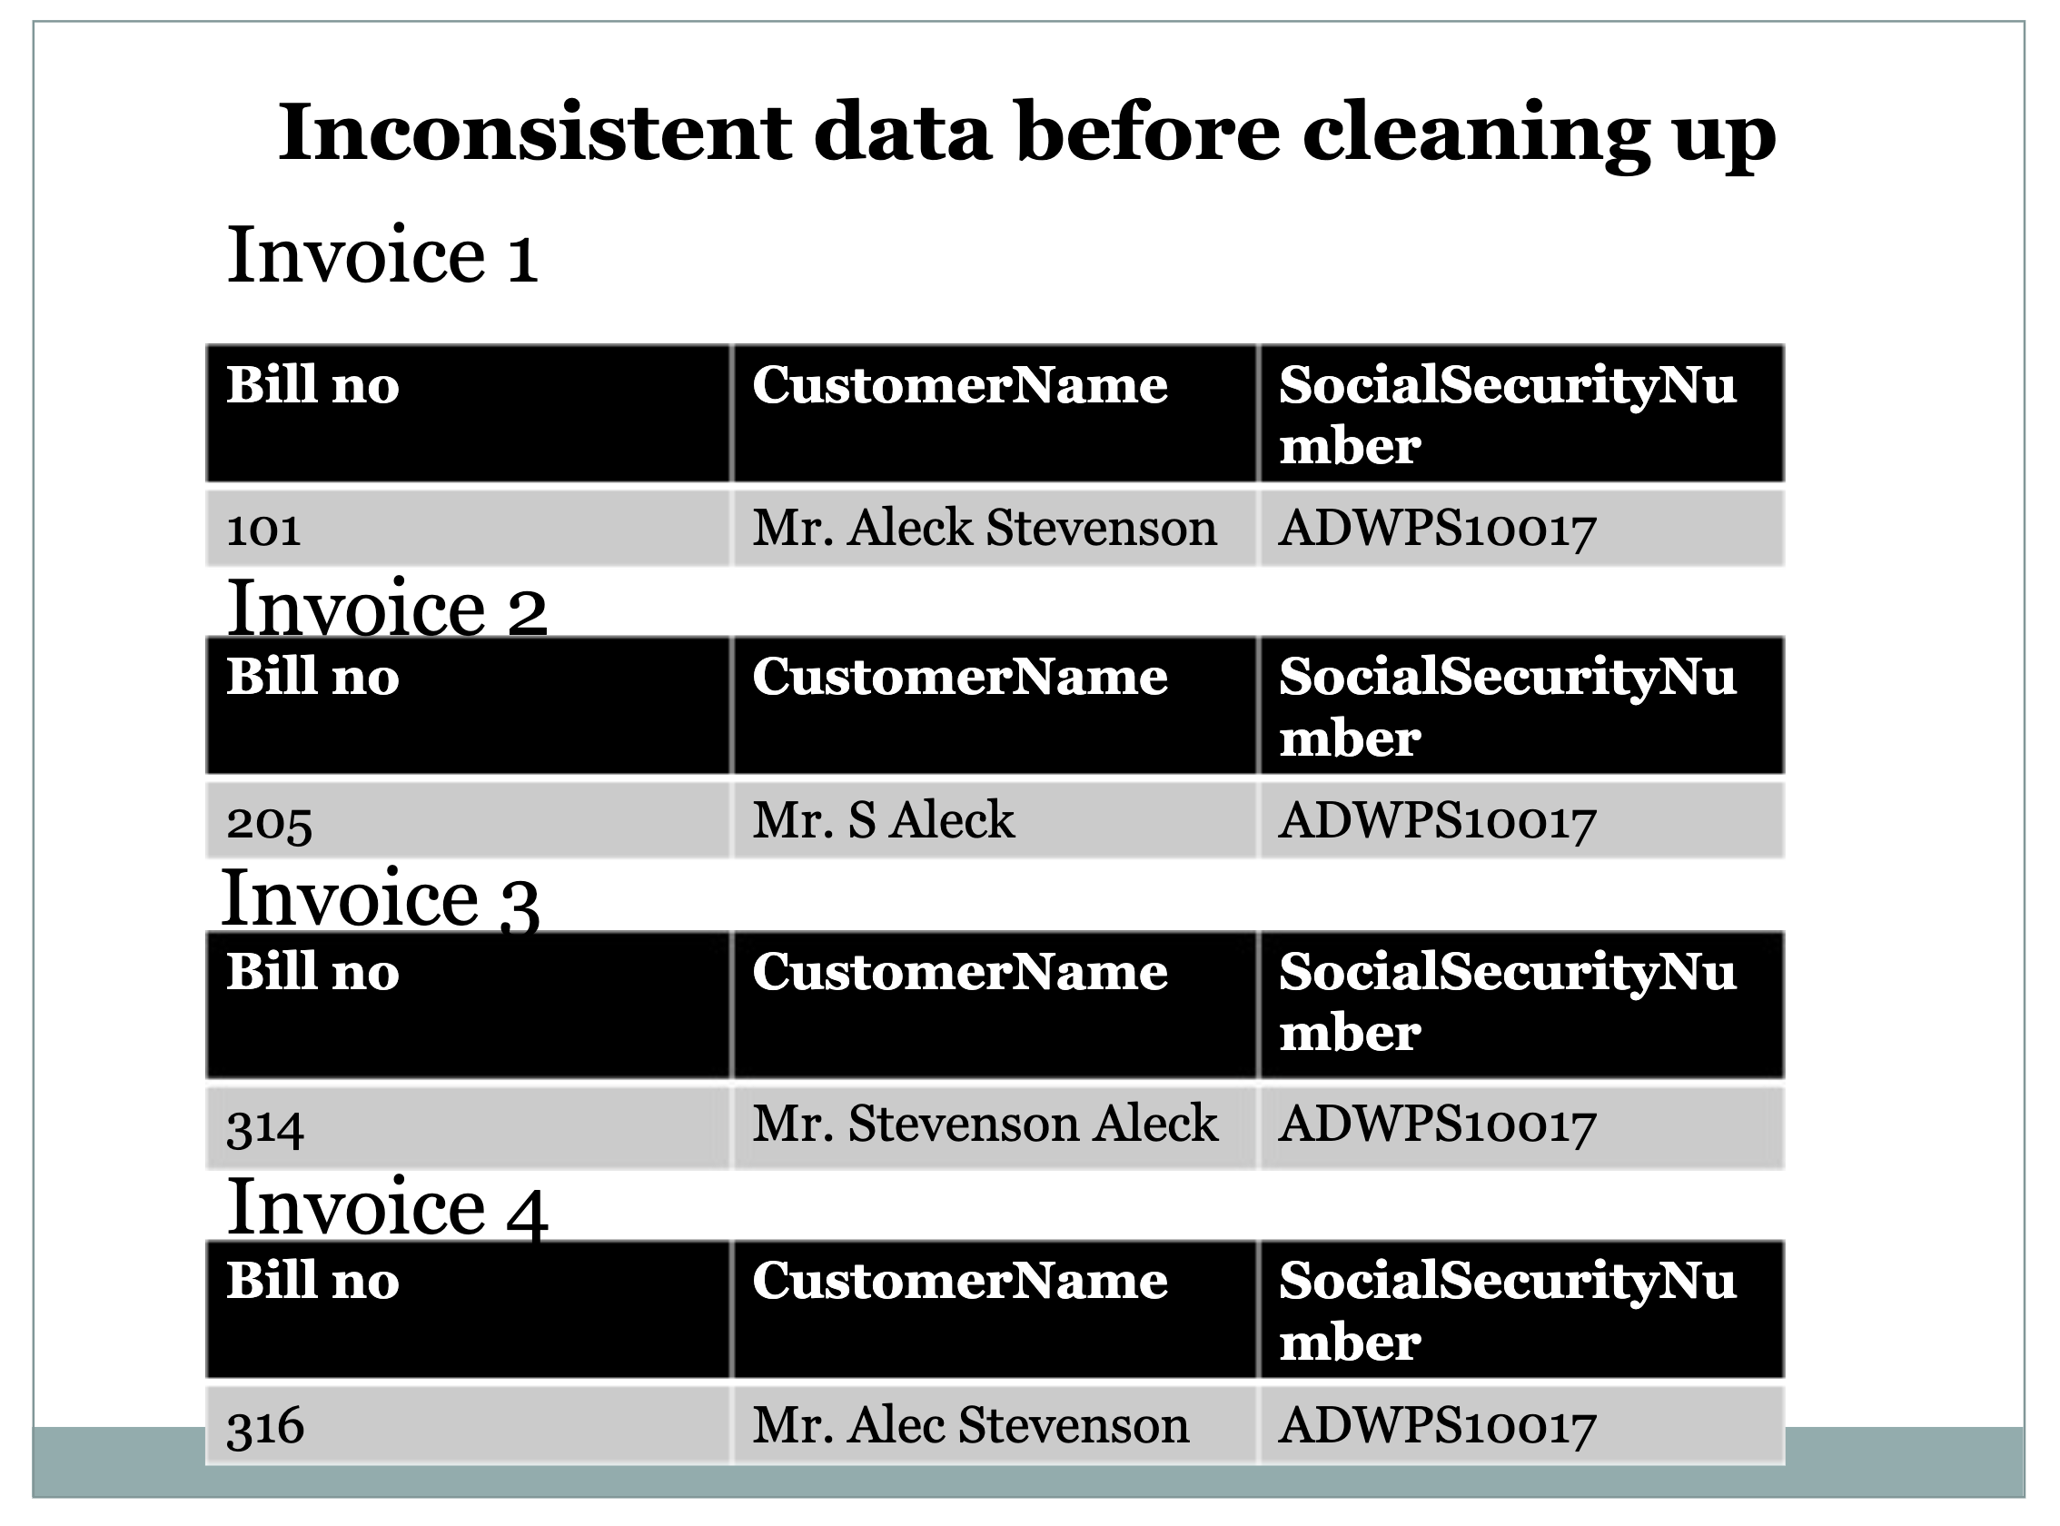

Slide 14
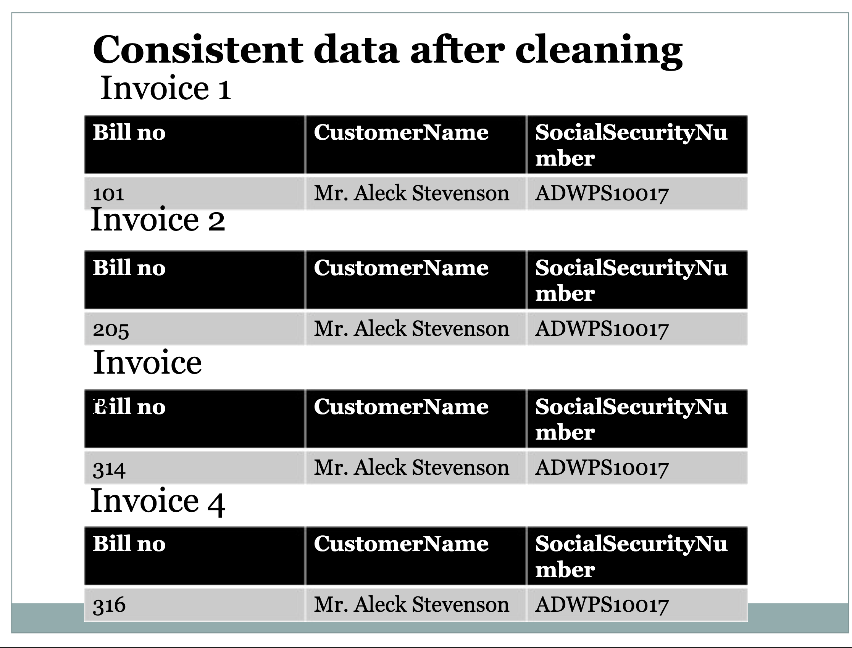

Slide 15
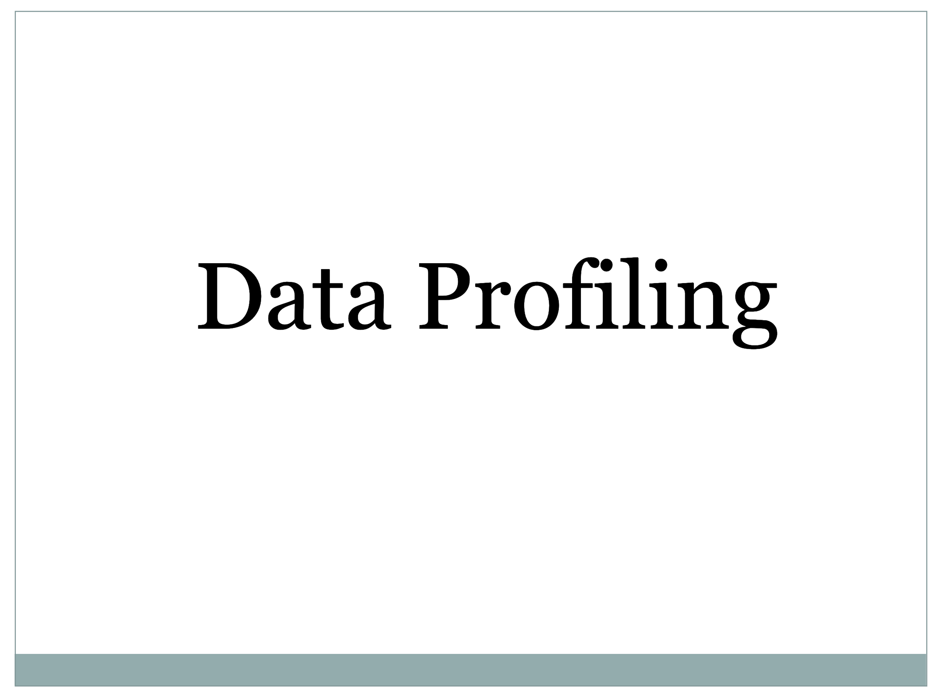

Slide 16
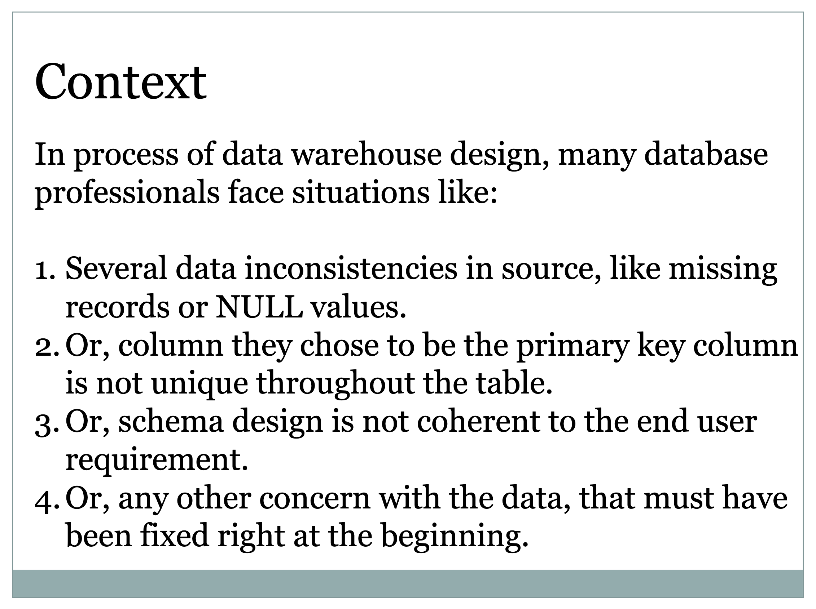

Slide 17
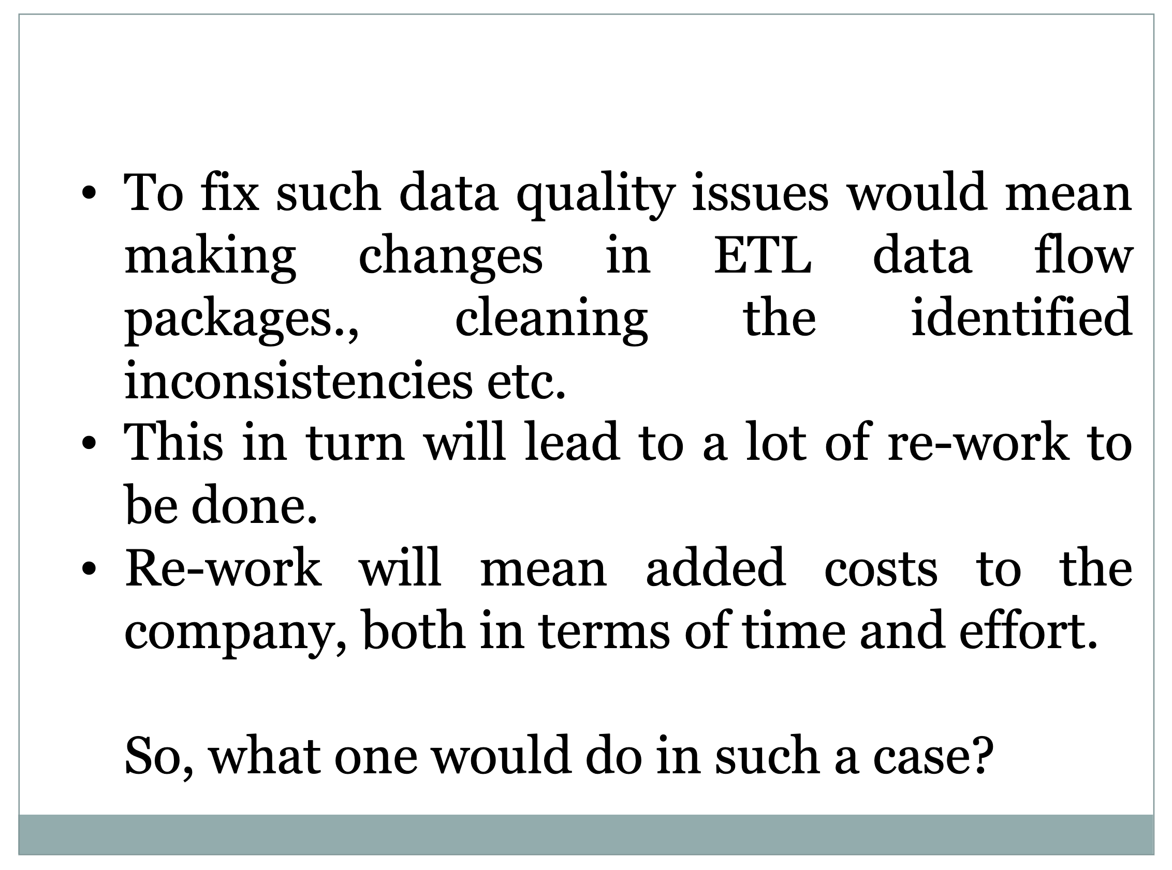

Slide 18
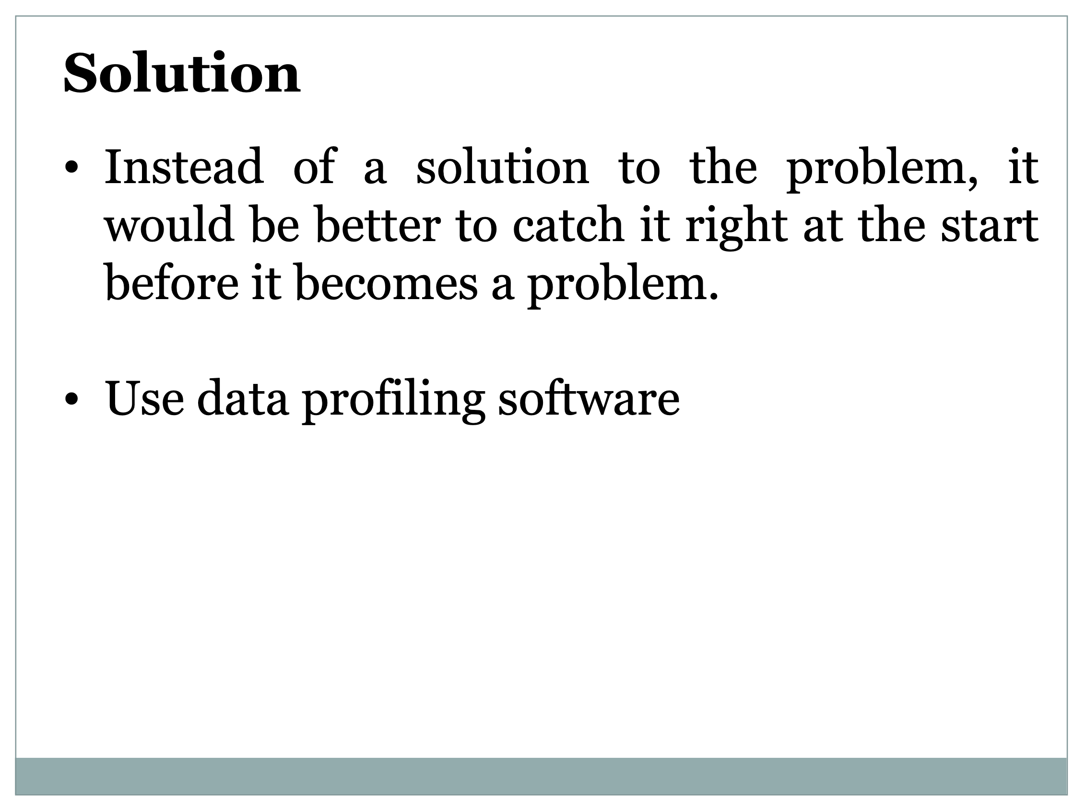

Slide 19
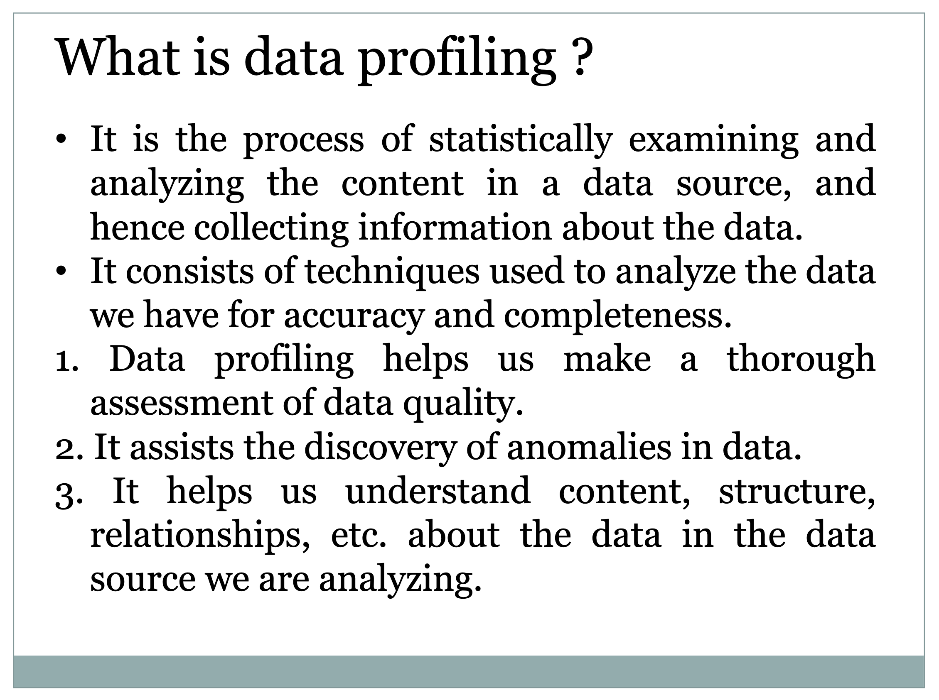

Slide 20
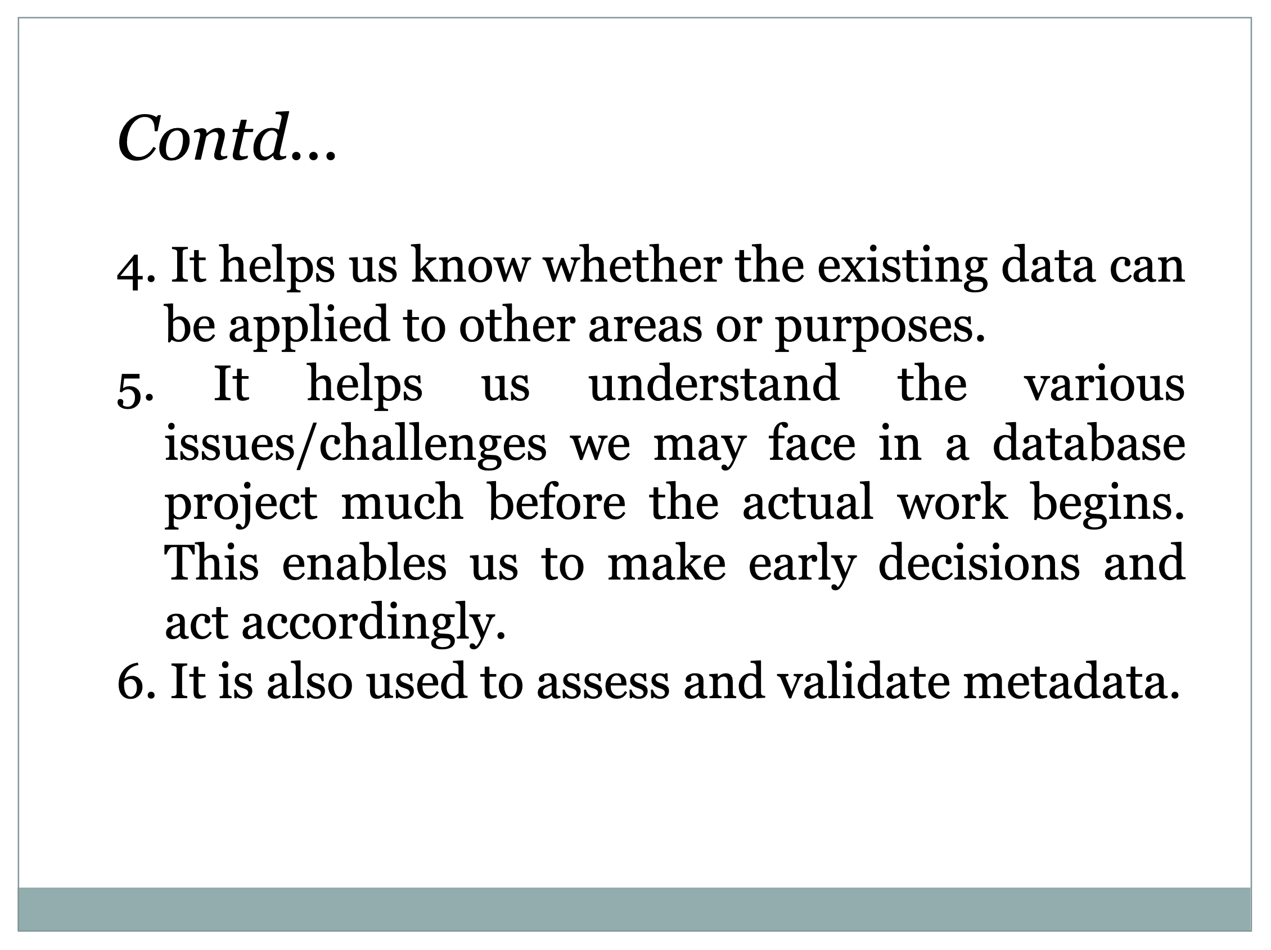

Slide 21
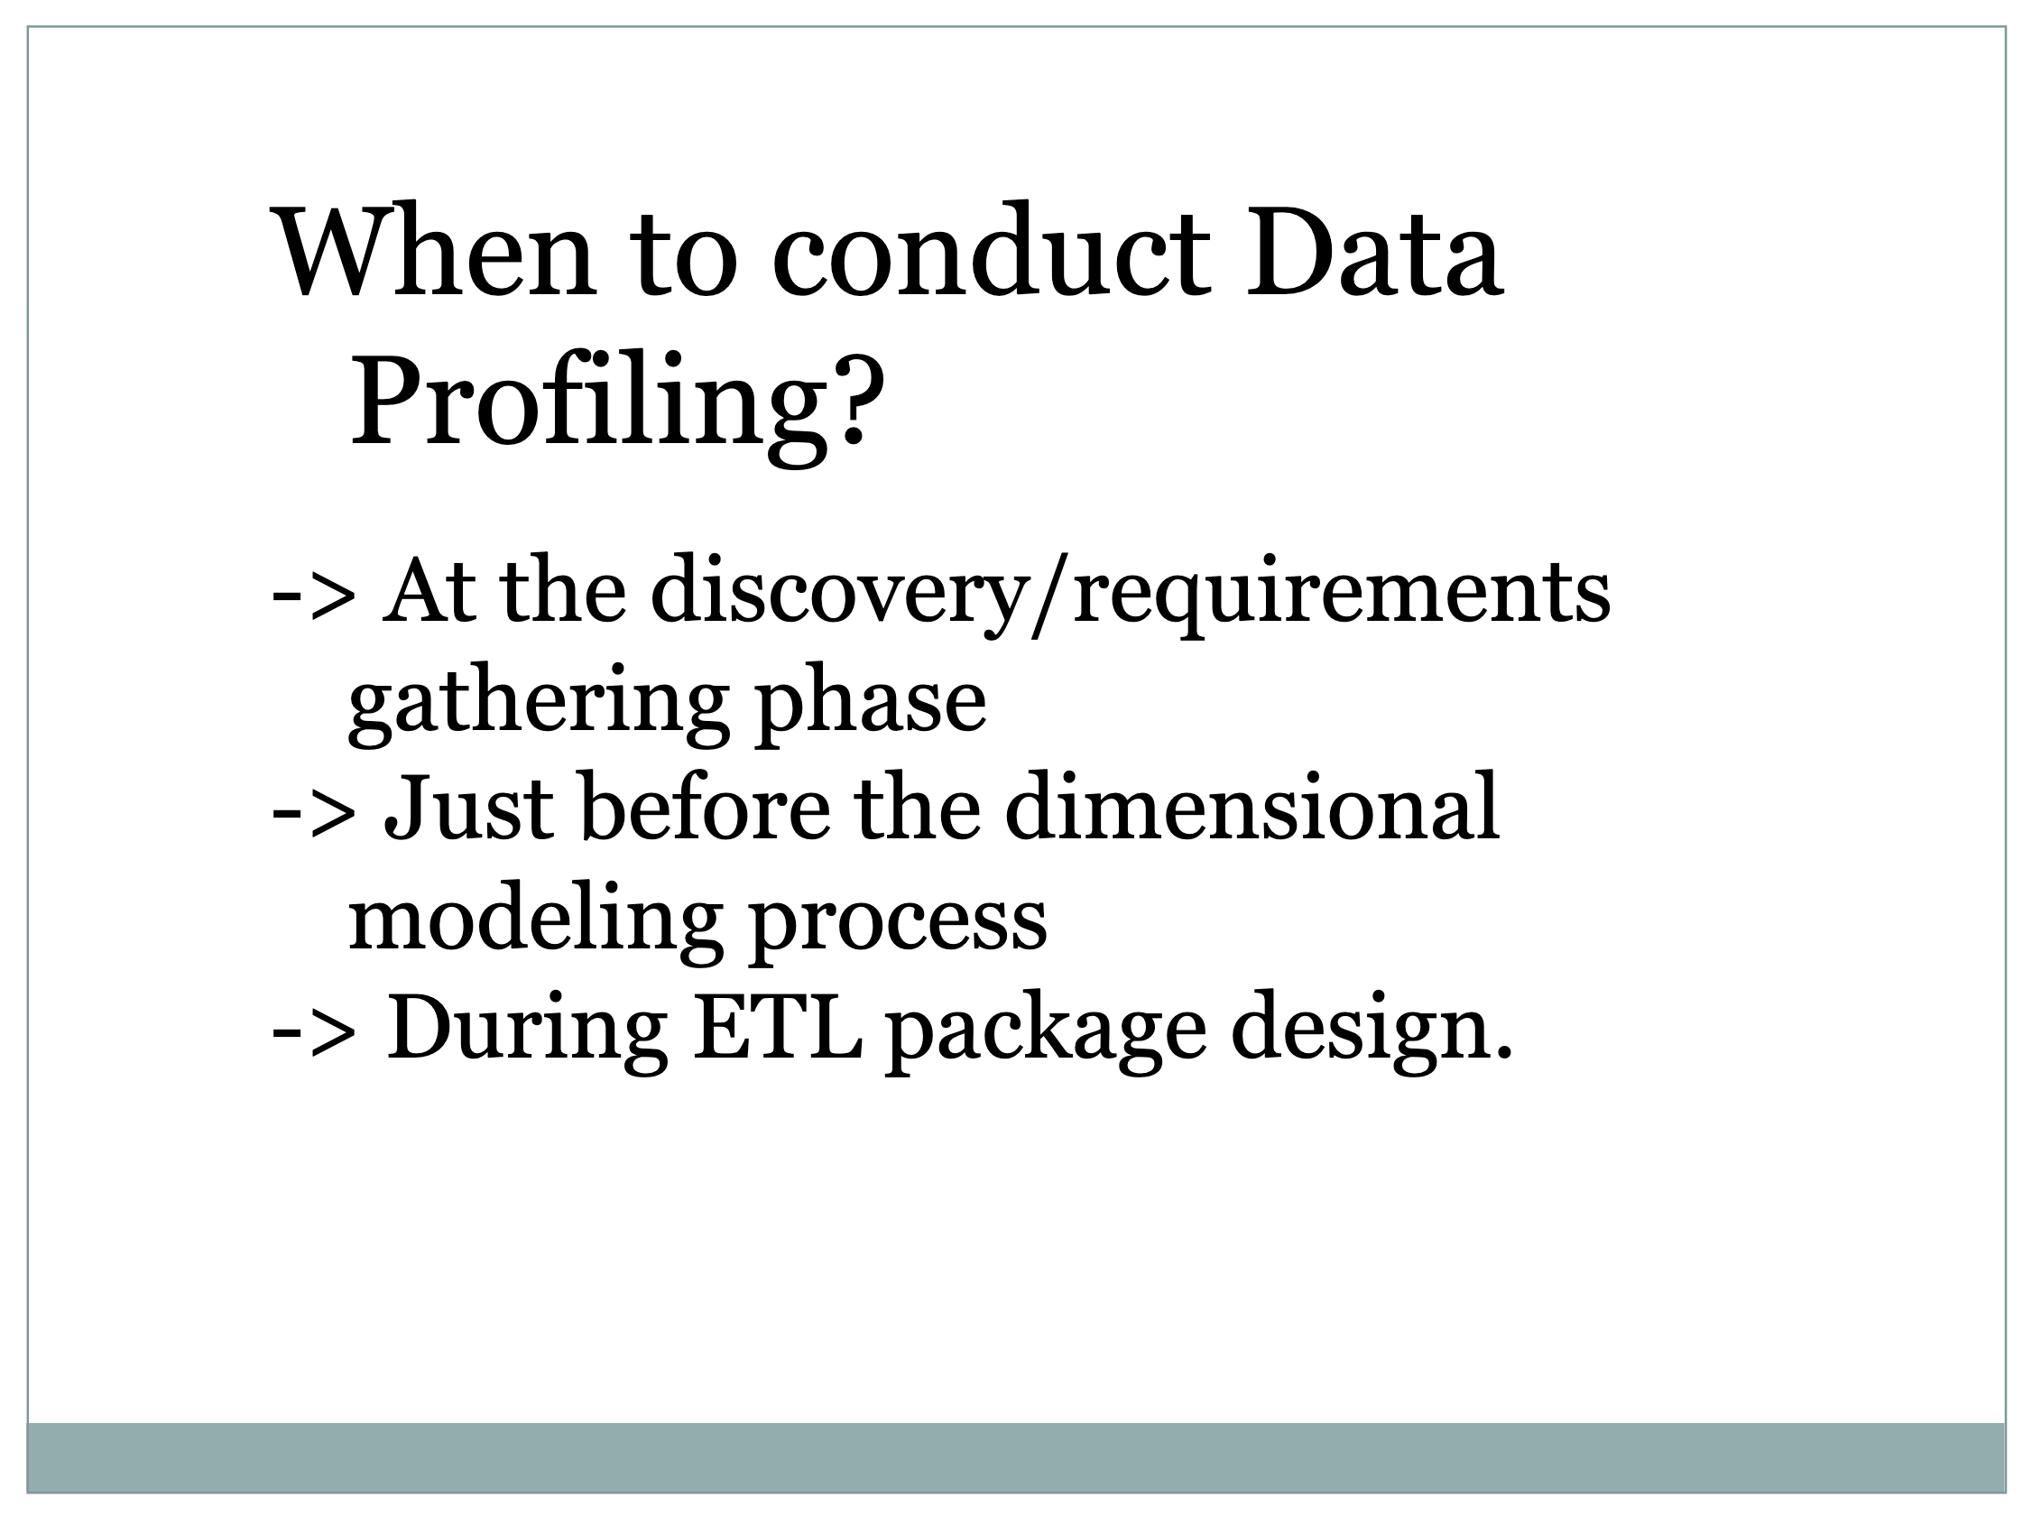

Slide 22
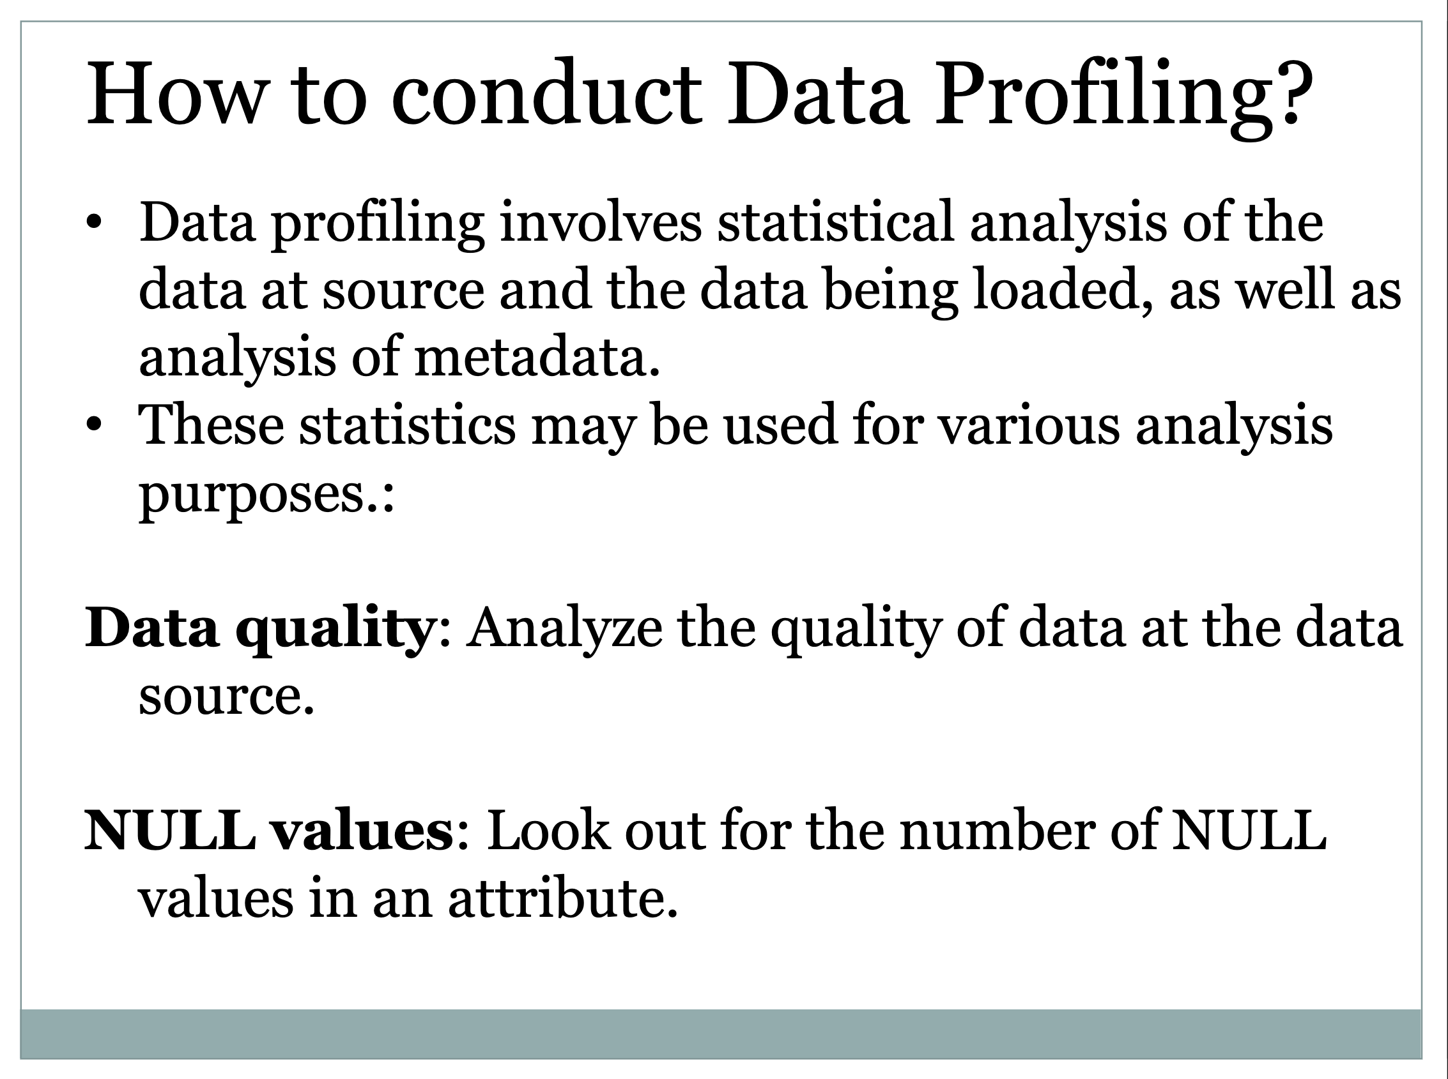

Slide 23
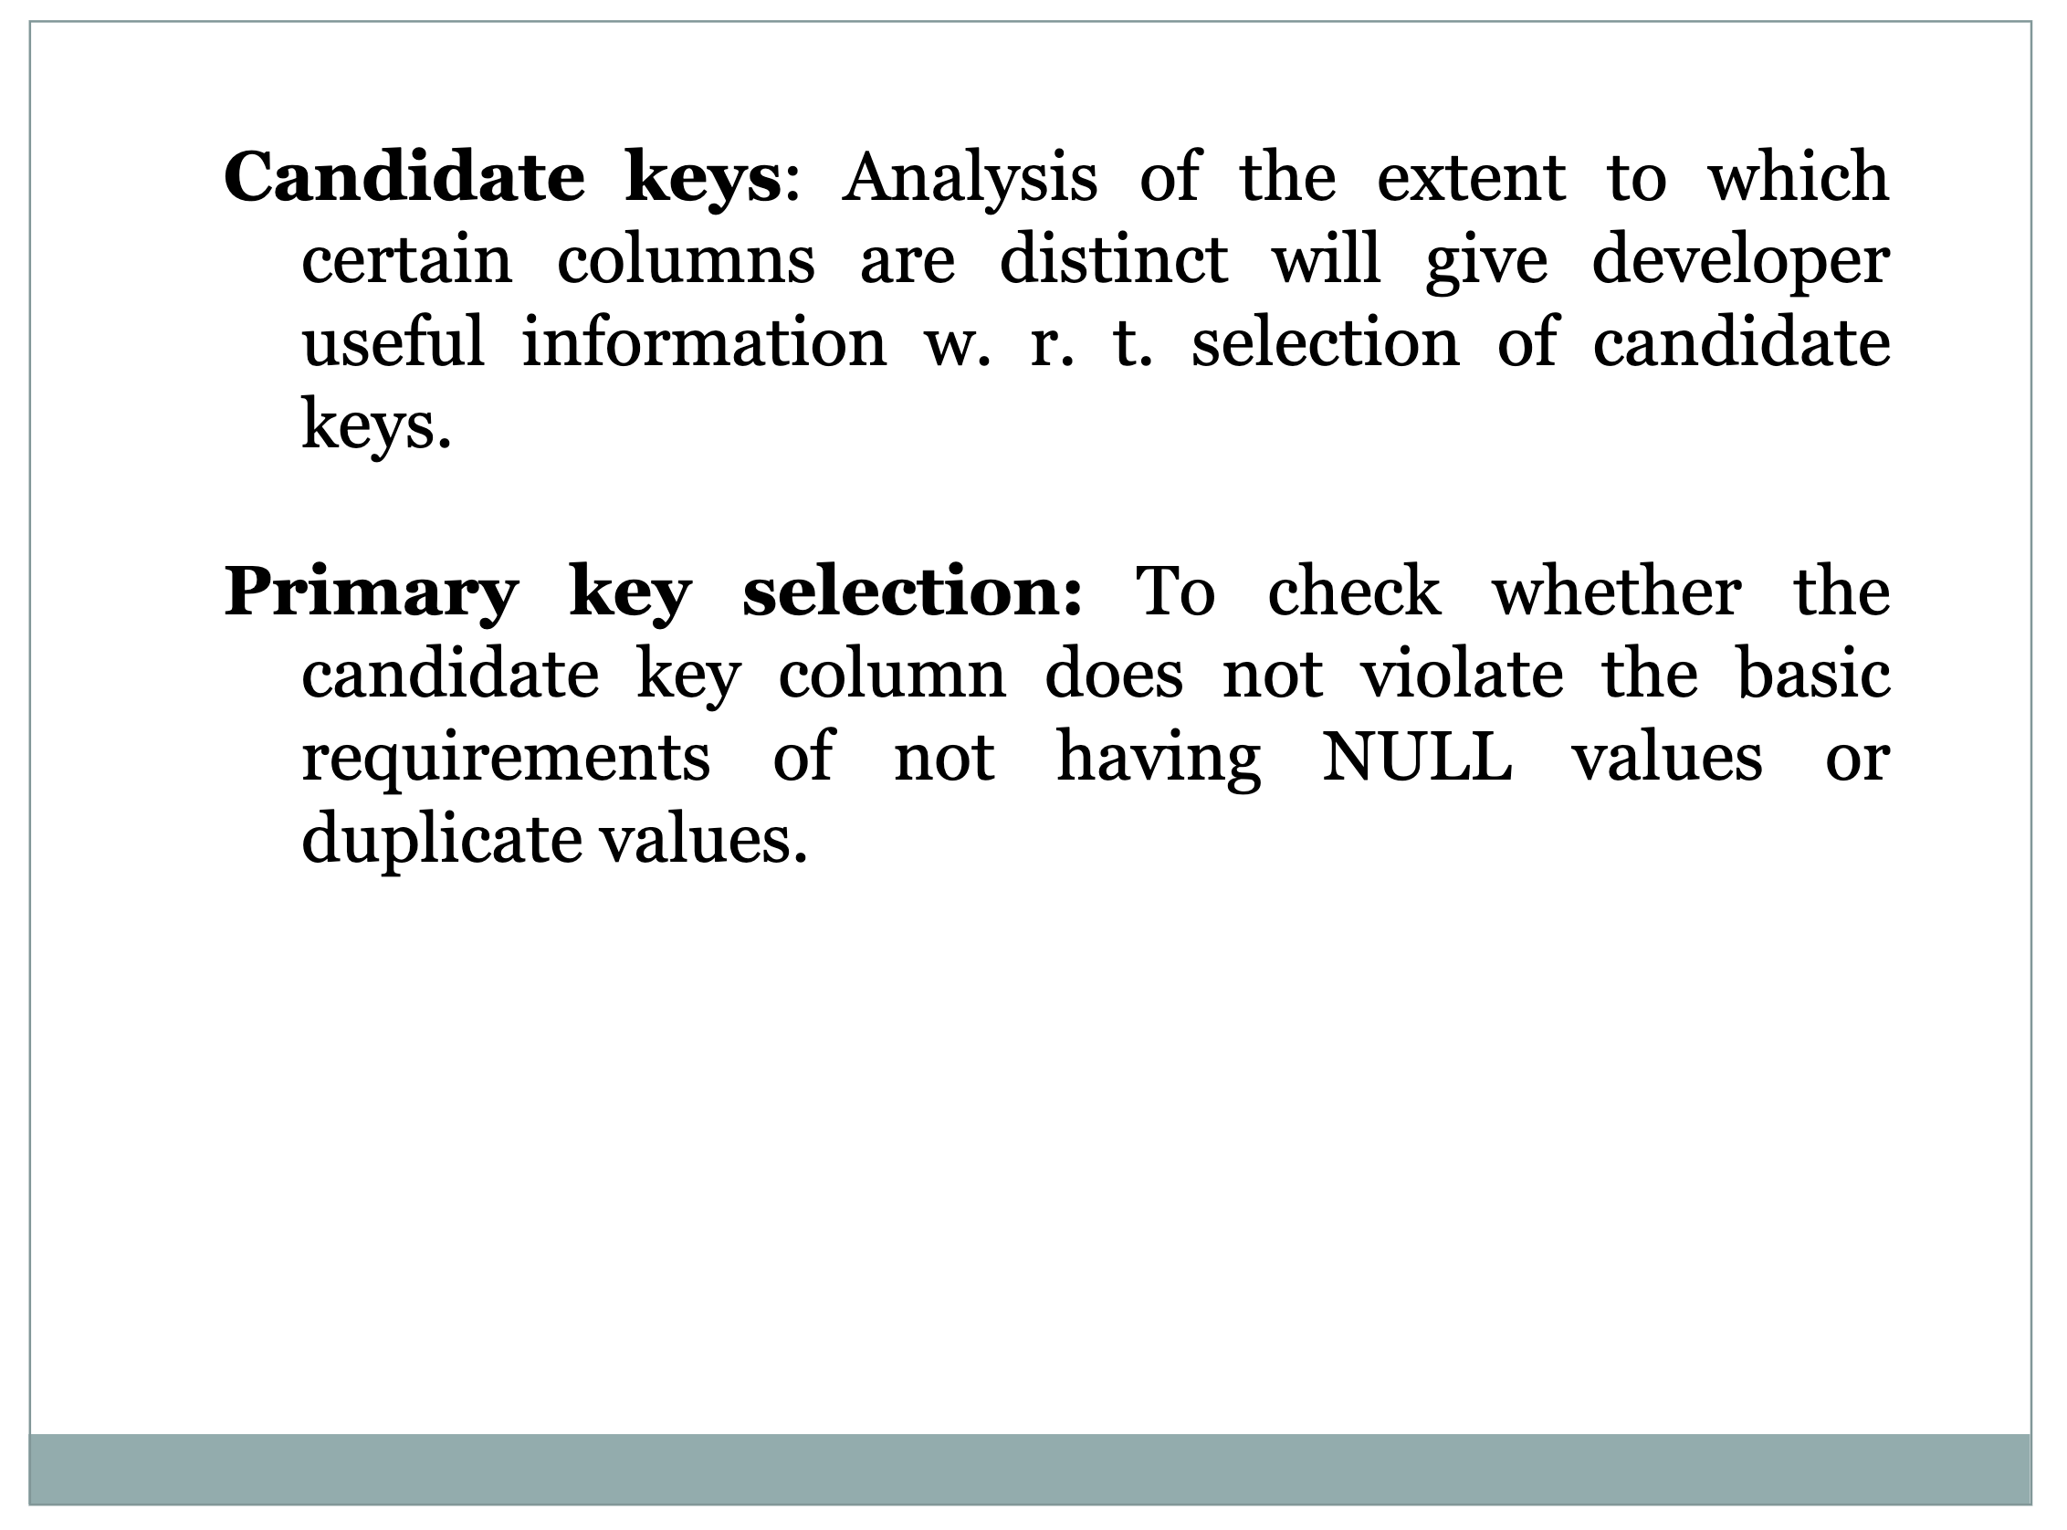

Slide 24
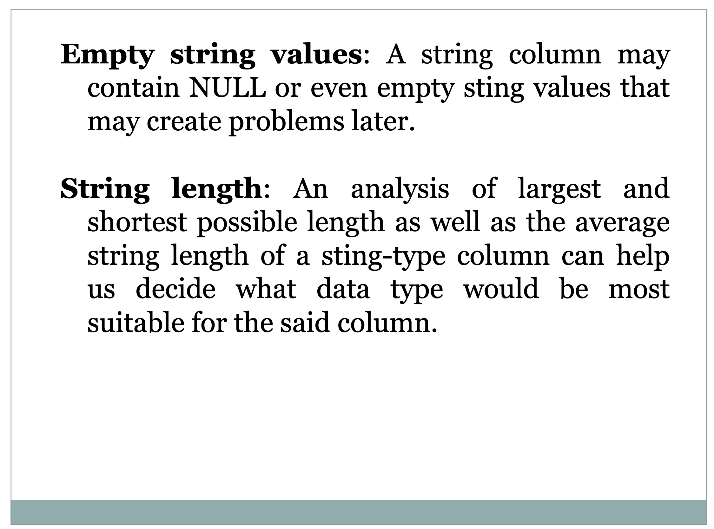

Slide 25
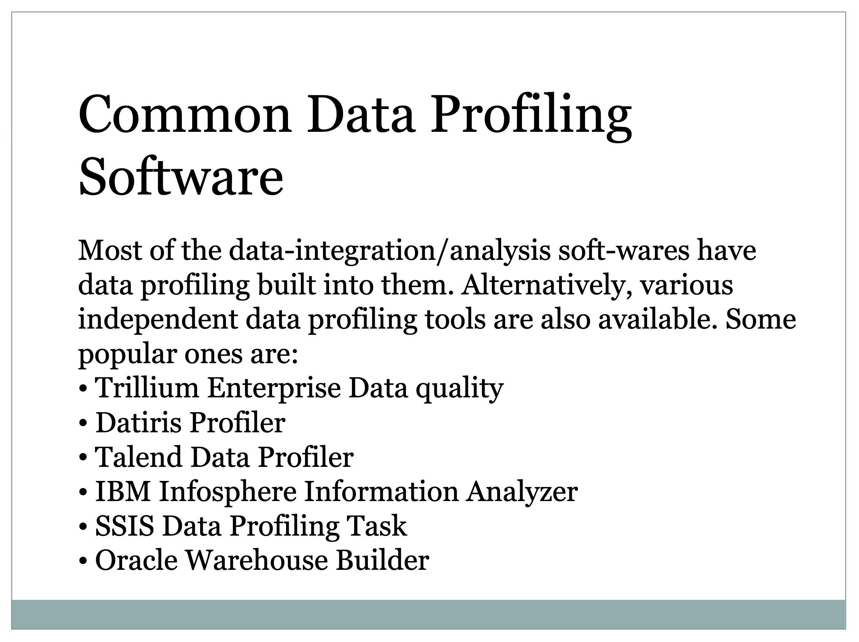

Slide 26
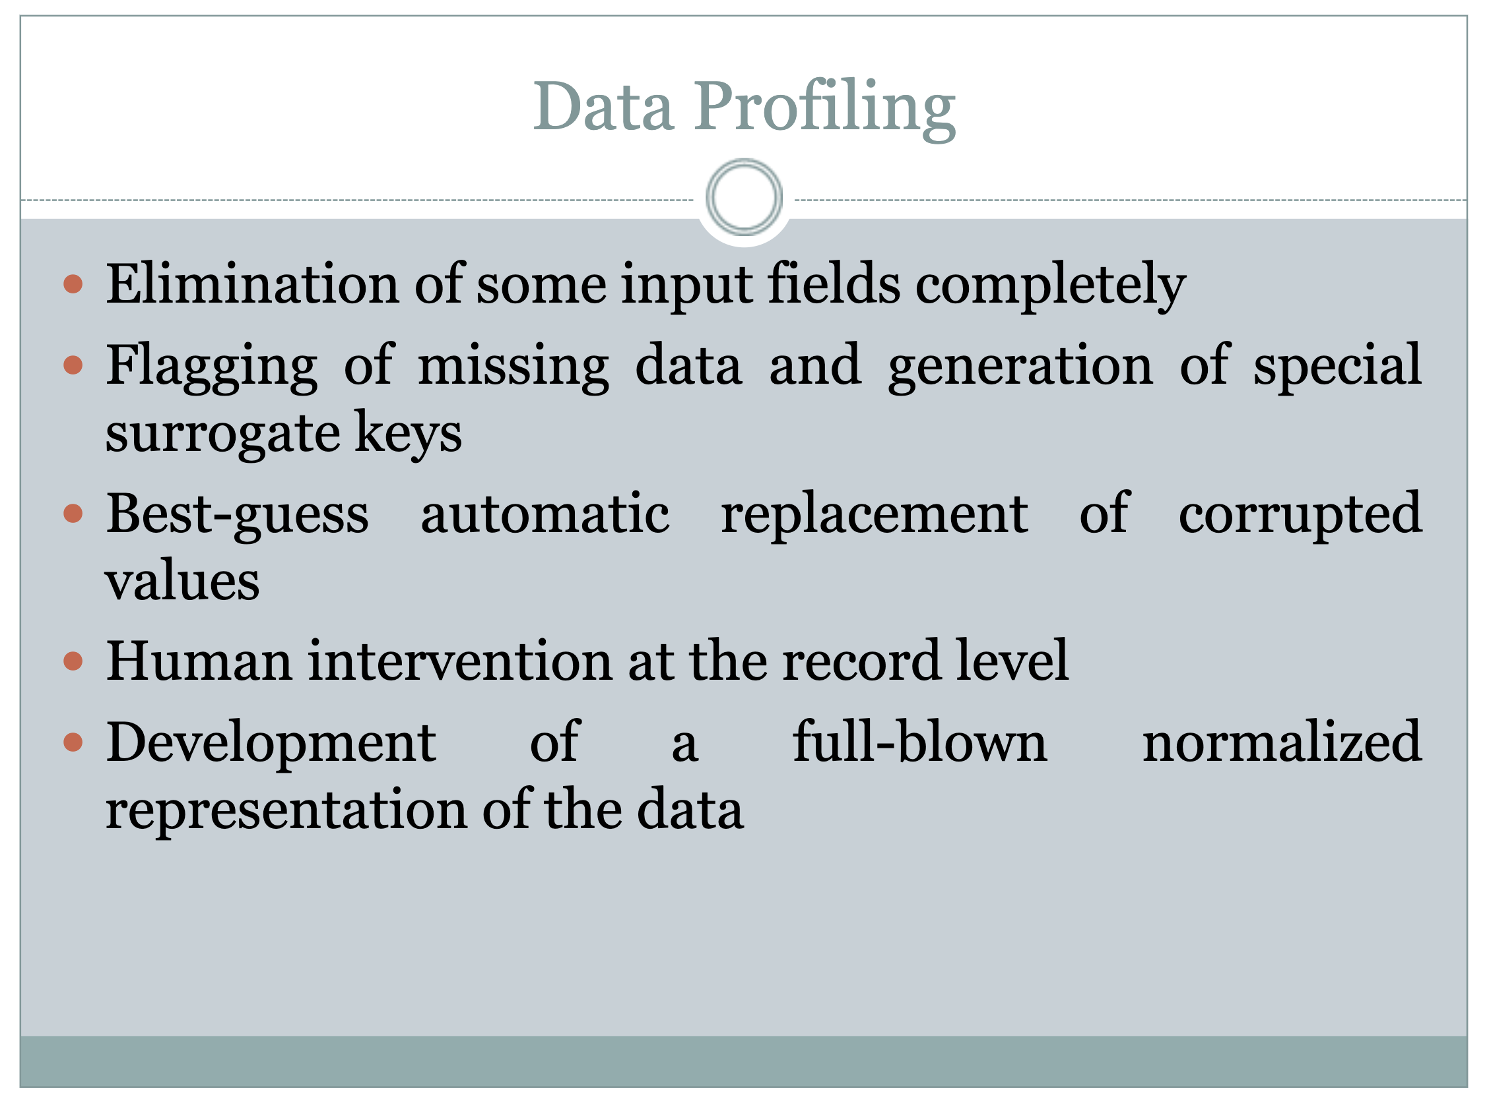

Slide 27
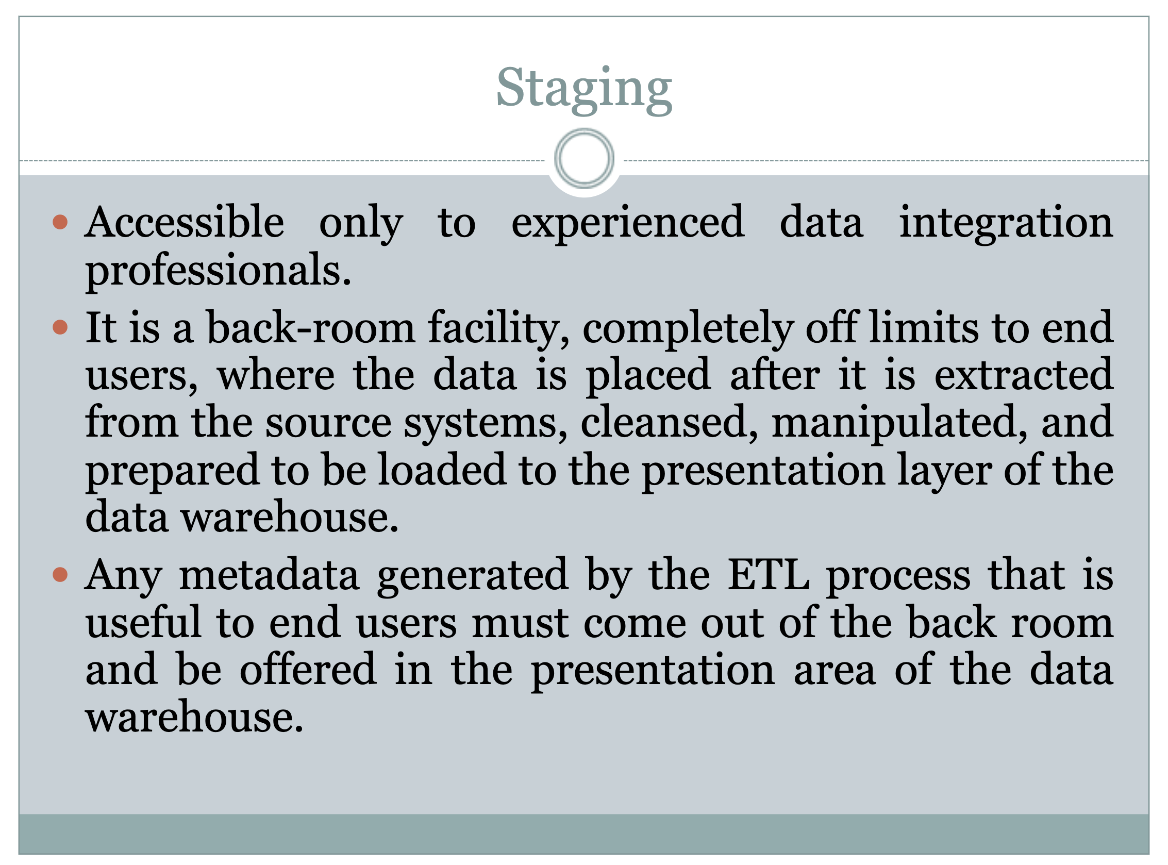

Slide 28
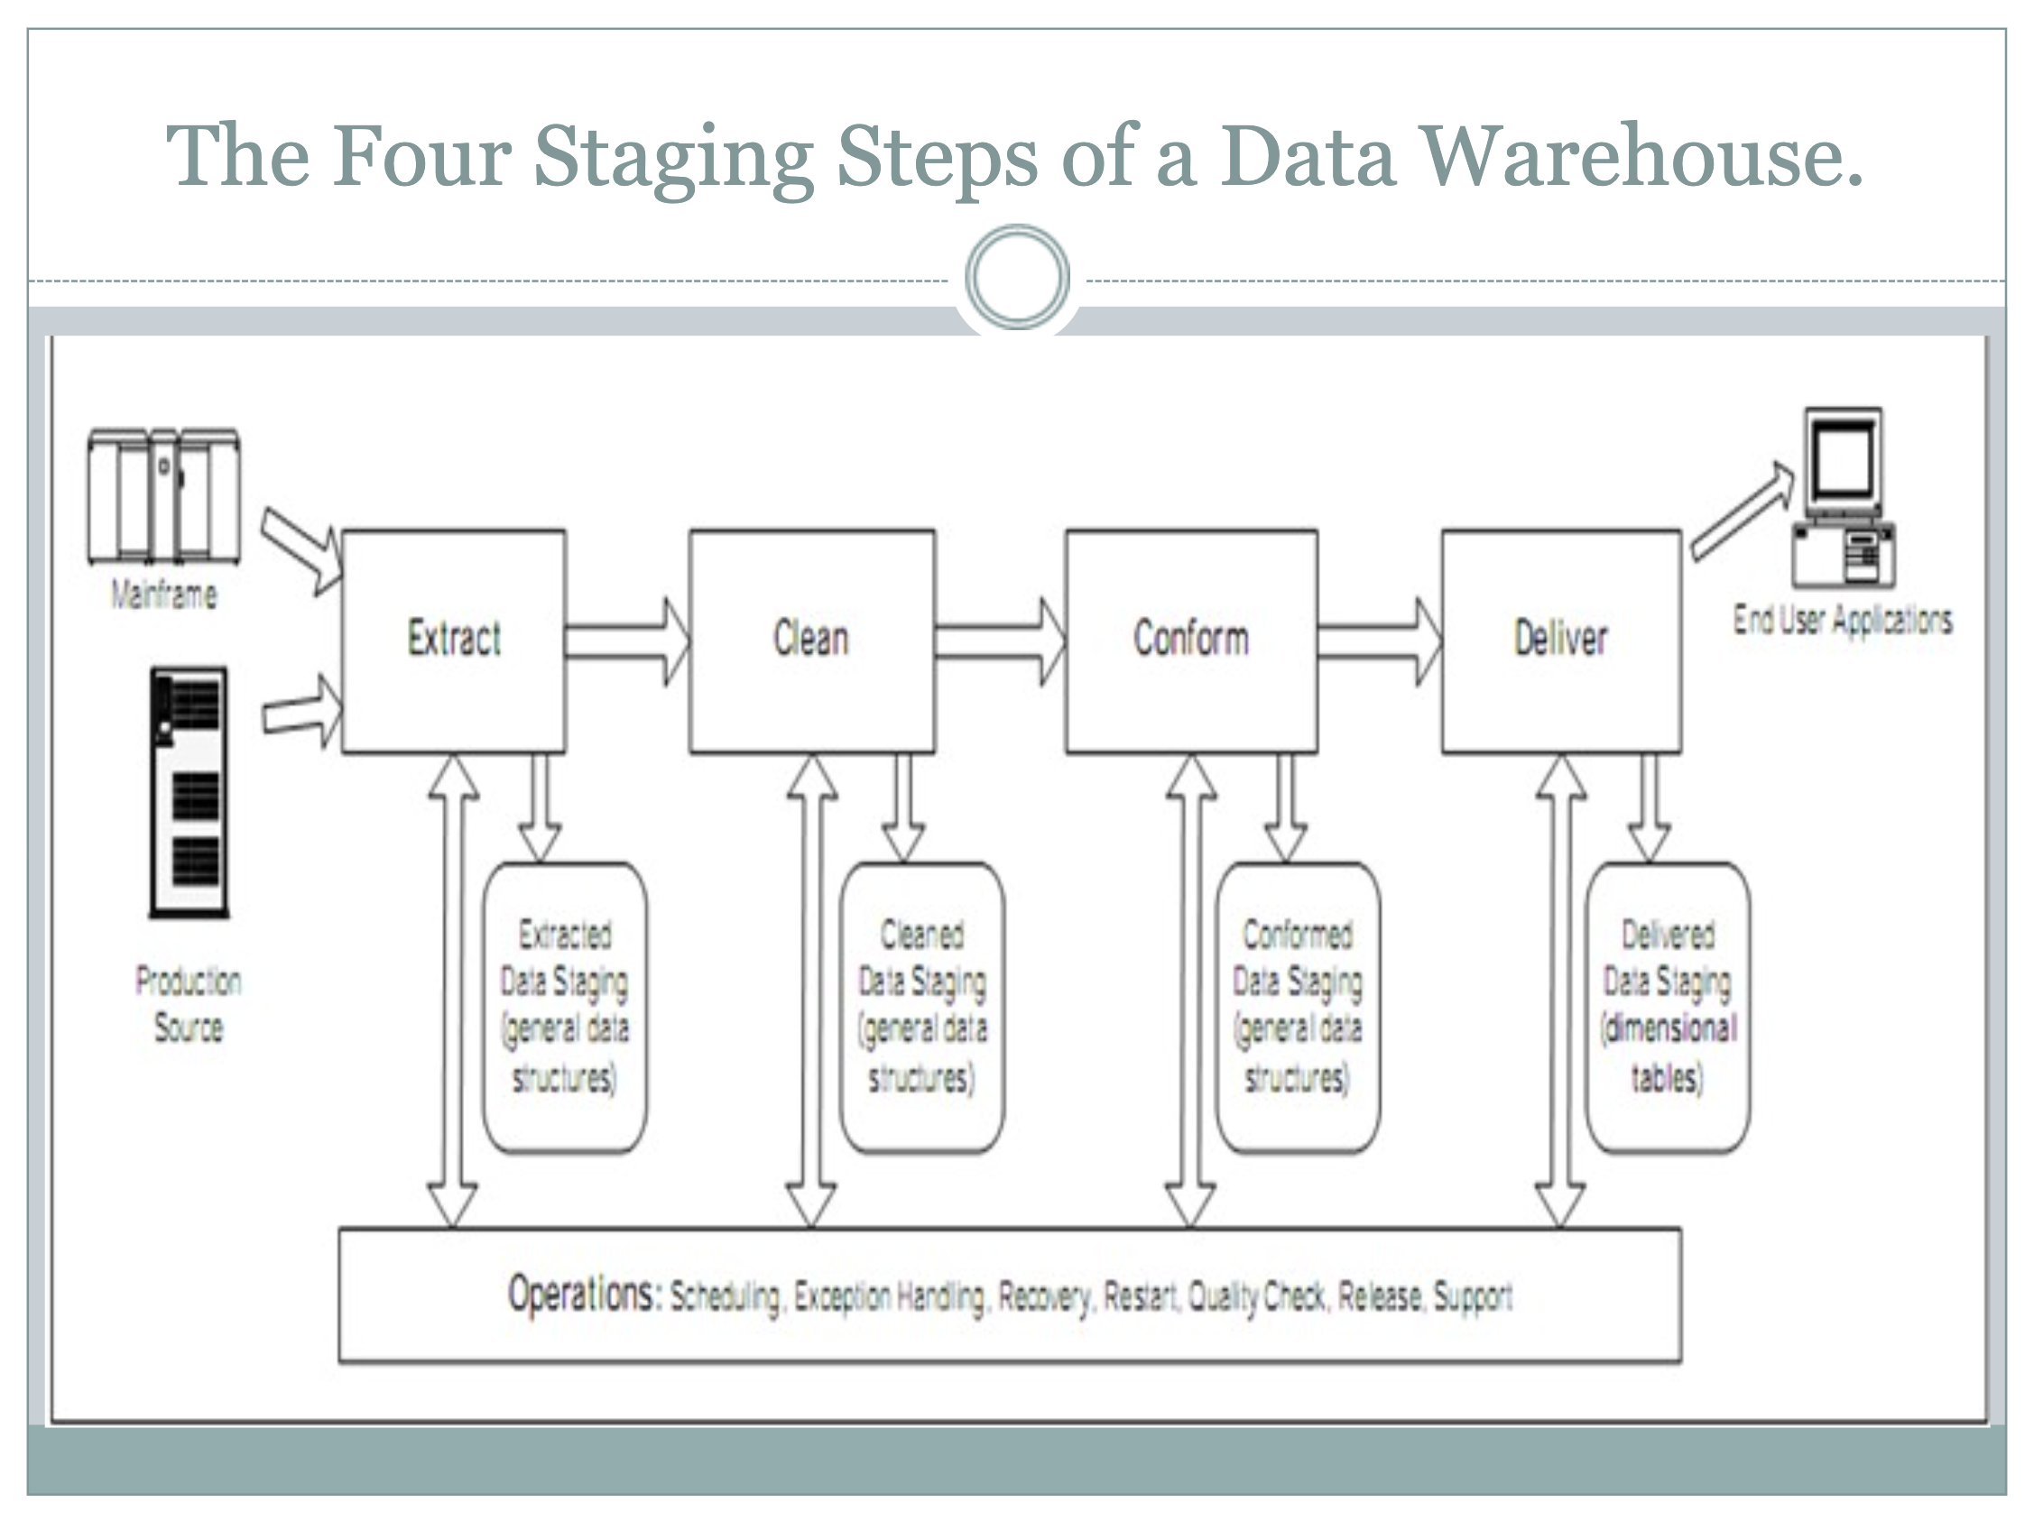

Slide 29
Types of Data Extraction
Logical Data Extraction
Full Extraction
Incremental Extraction
2. Physical Data Extraction
Online Data Extraction
Offline Data Extraction

Slide 30
Full Extraction
The first time you replicate any source, you must do a full extraction.
Some data sources have no way to identify data that has been changed, so reloading a whole table may be the only way to get data from that source.
Full extraction involves high volumes of data, which can put a load on the network, it’s not the best option if you can avoid it.
Example
Exporting full flat file.

Slide 31
Incremental extraction
Incremental extraction is the process of taking only the data that has been altered since the last extraction.
Time to time extract the data.

Slide 32
Physical Data Extraction
Online extraction is a more popular option when the data is extracted directly from the source of the targeted data warehouse.
On the other hand, offline extraction doesn’t use direct connections because the extraction applies extraction routines outside the source.
Flat File
Dump File
Archive logs

Slide 33
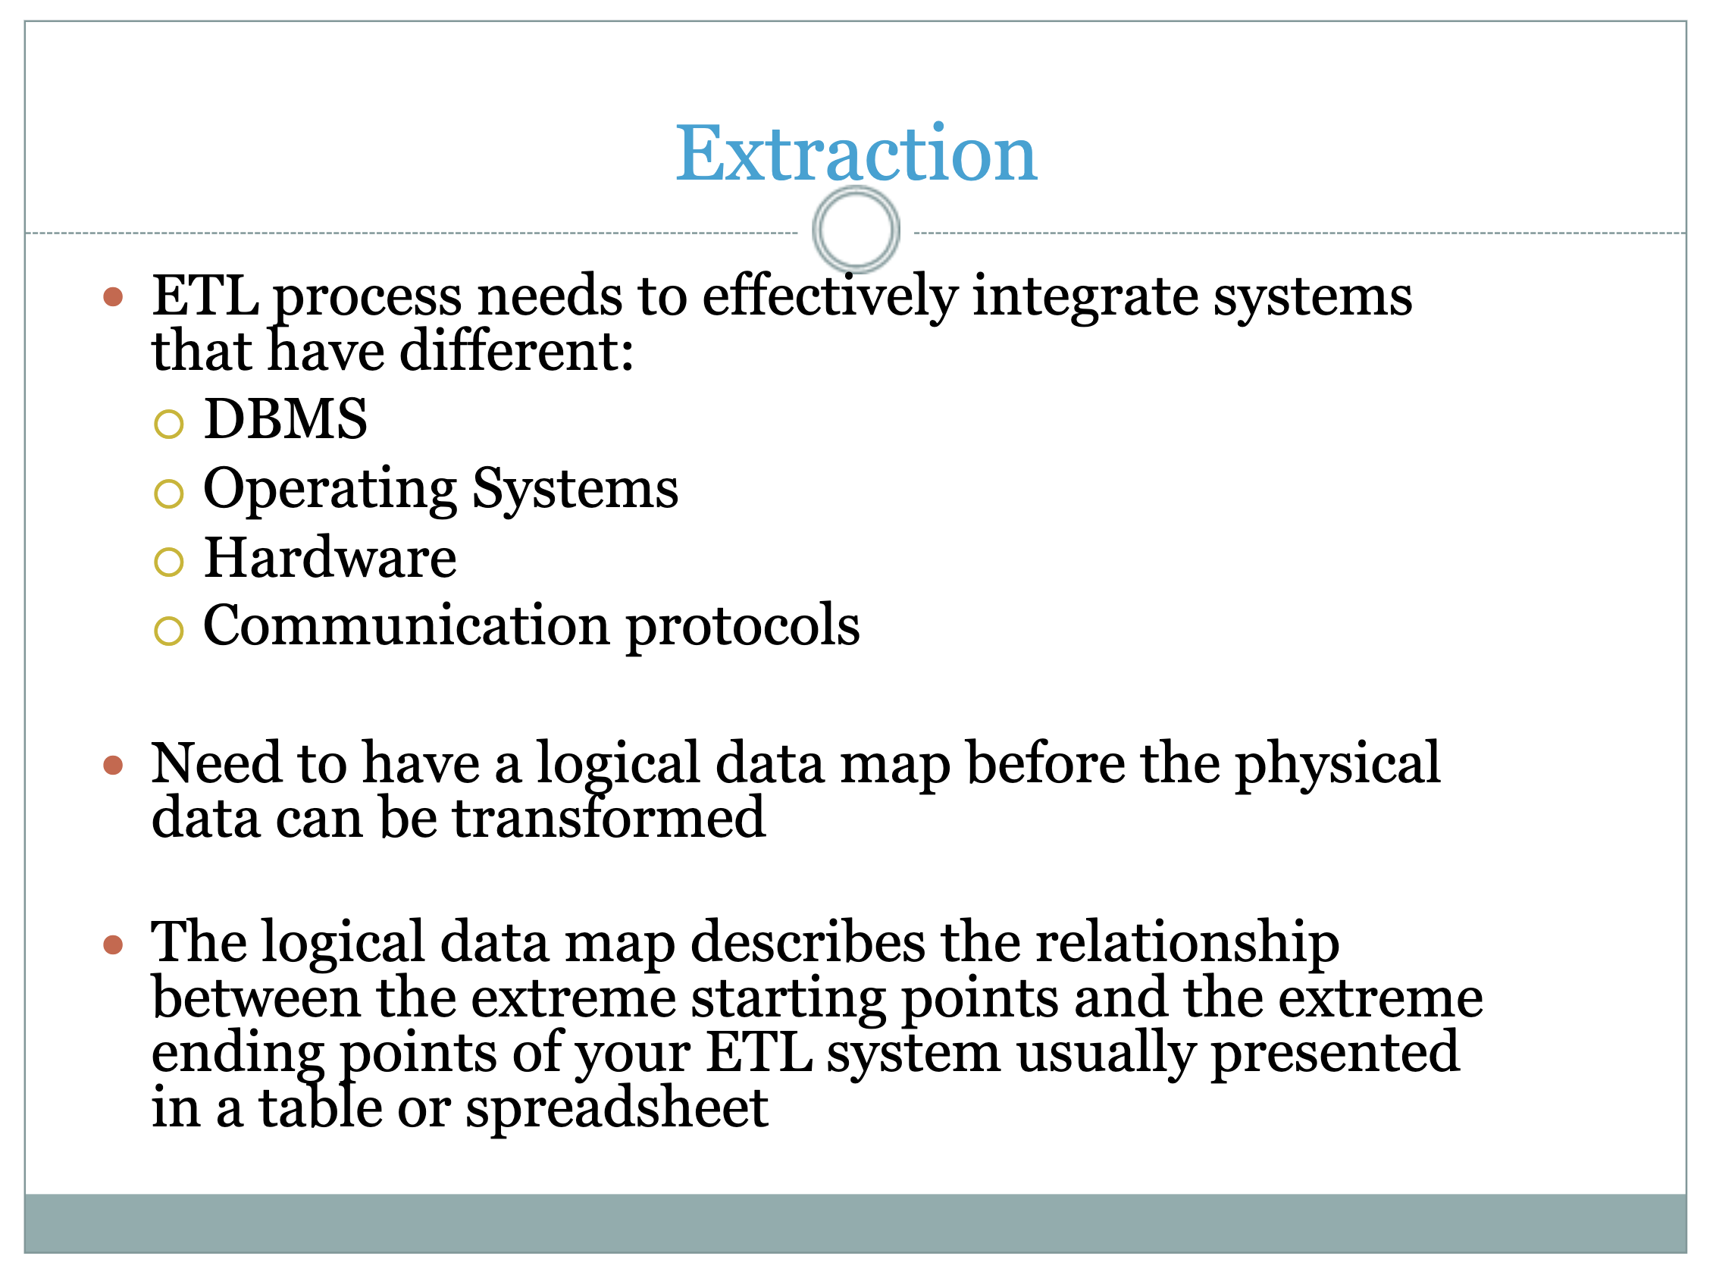

Slide 34
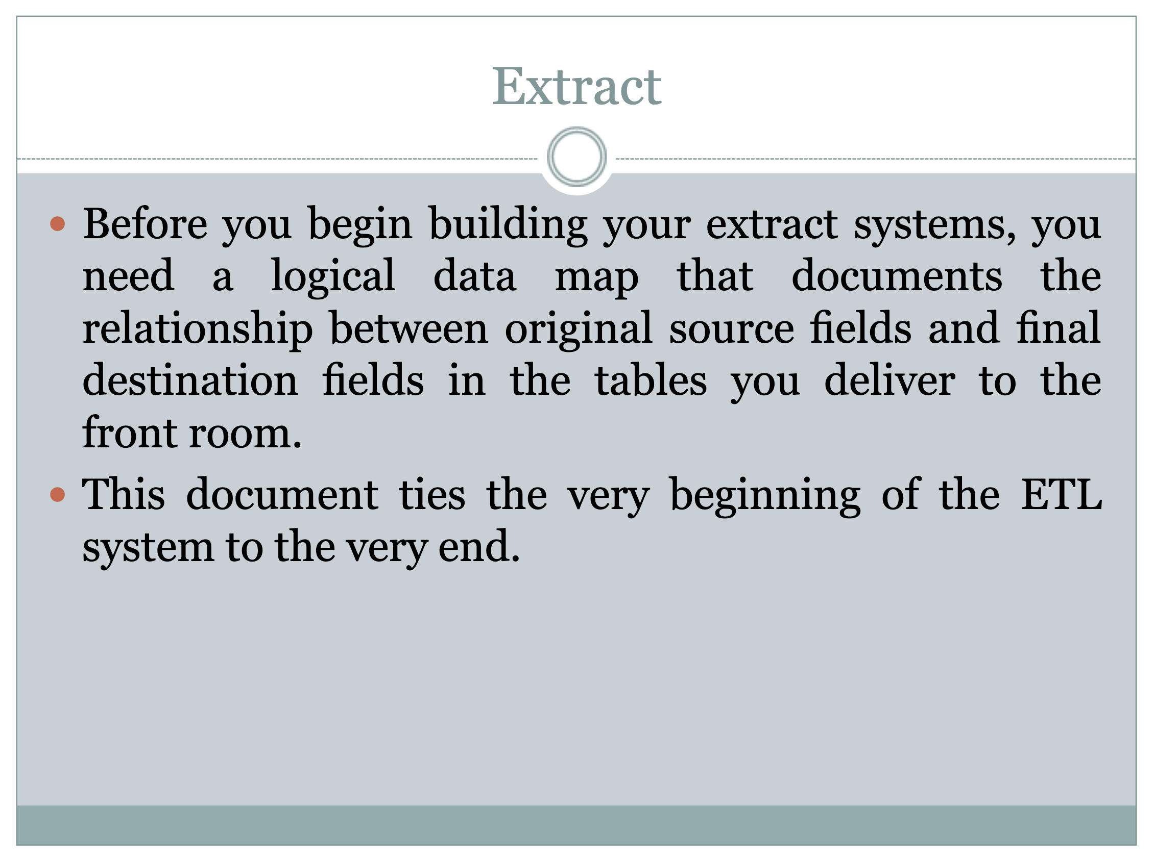

Slide 35
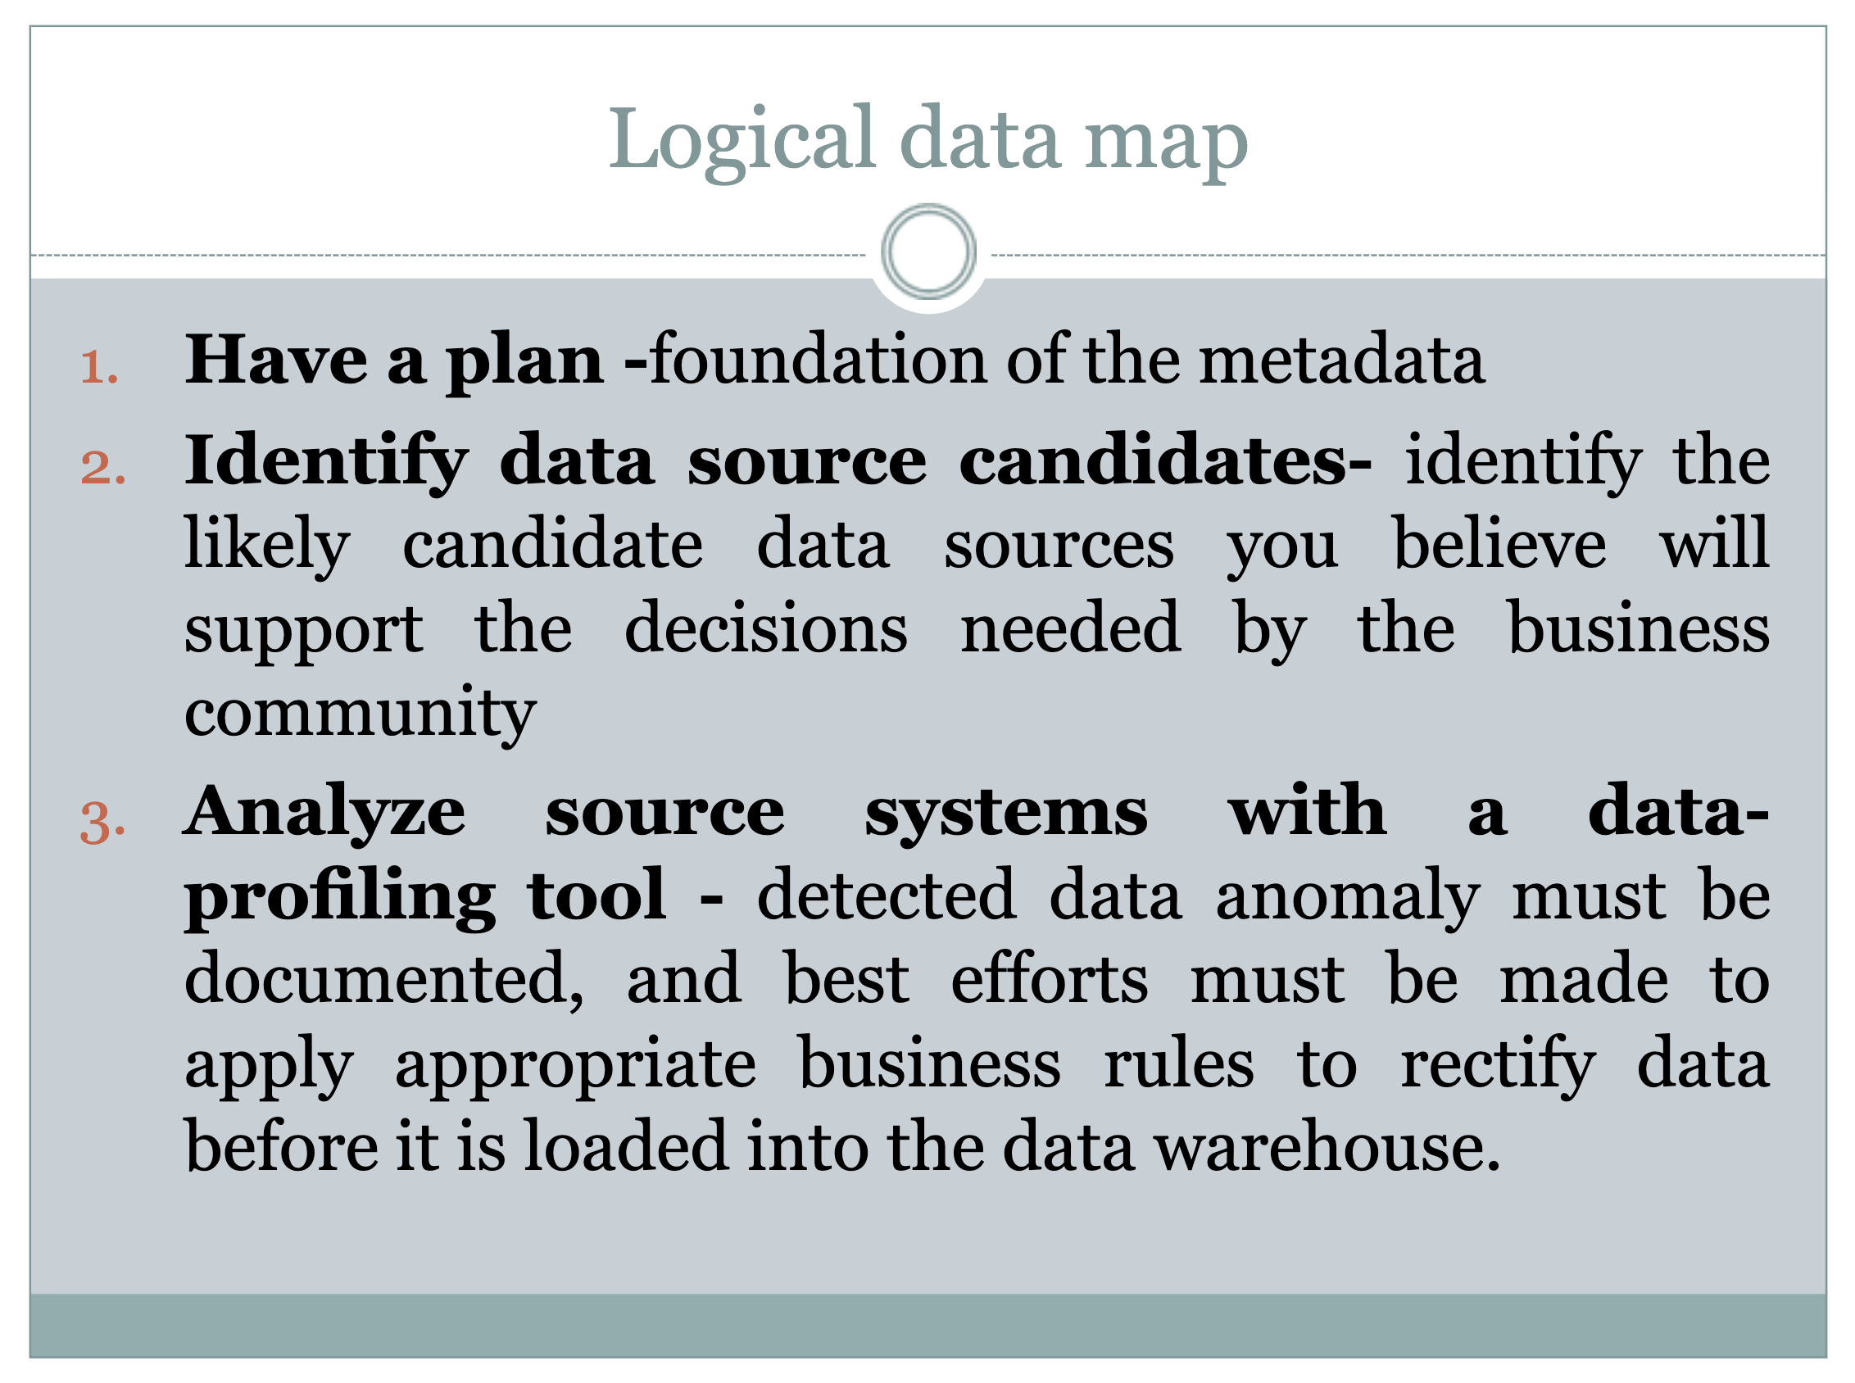

Slide 36
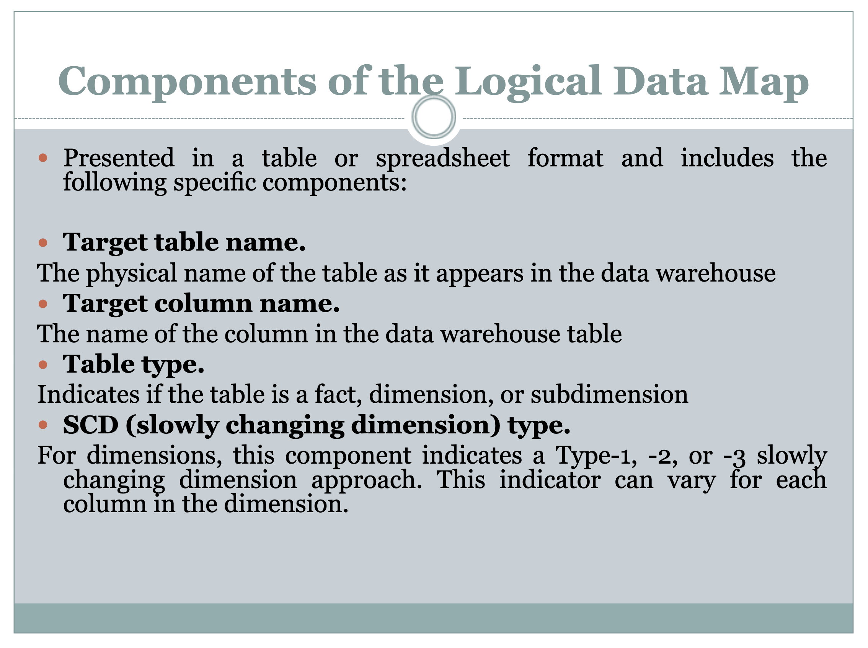

Slide 37
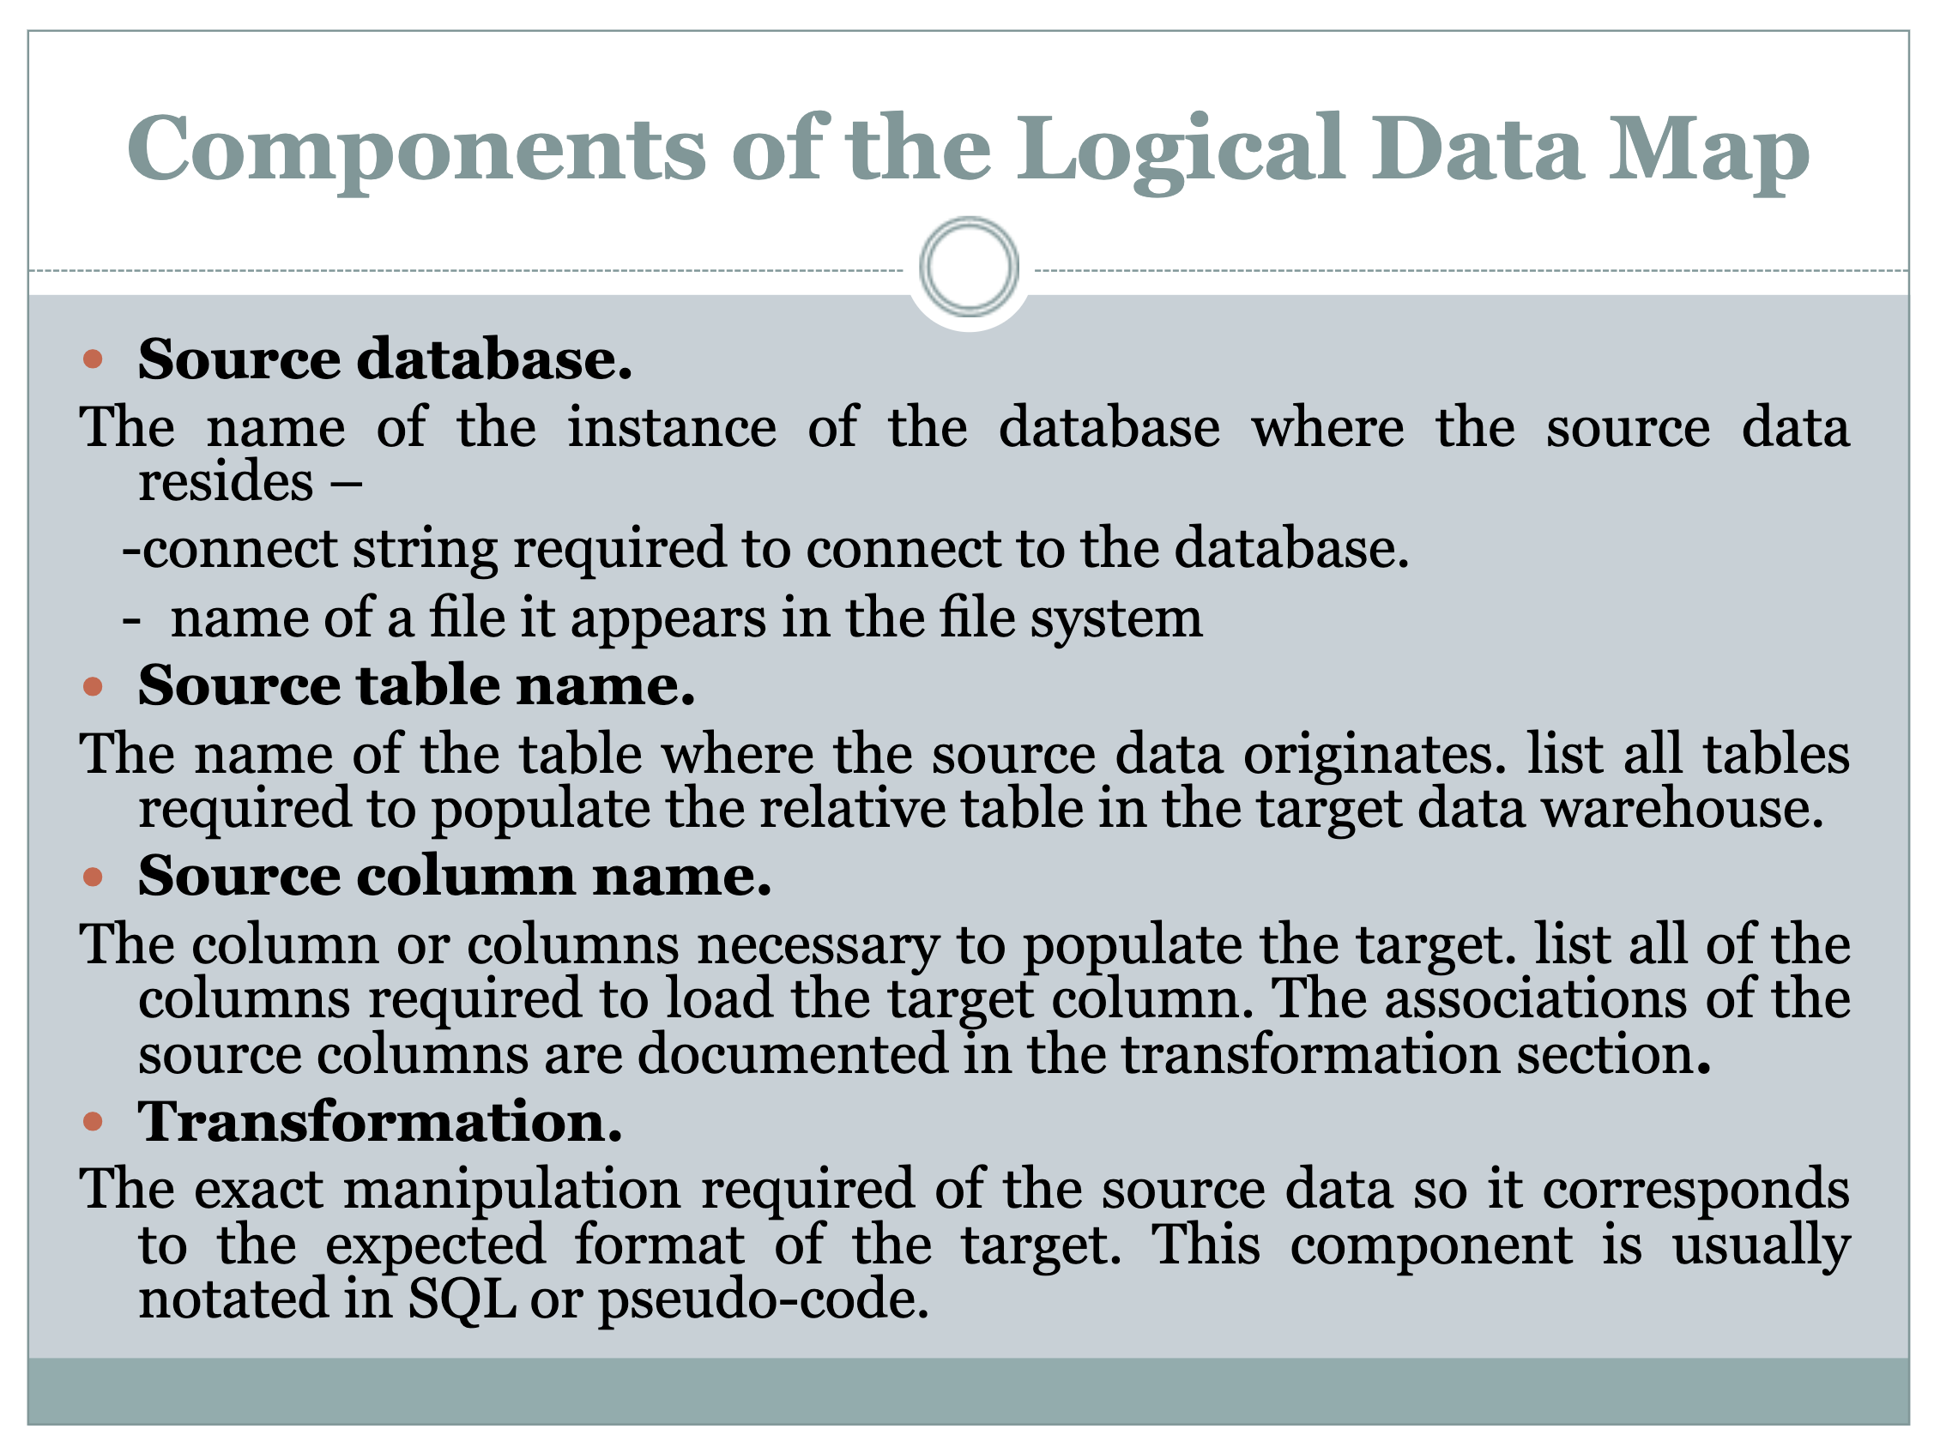

Slide 38
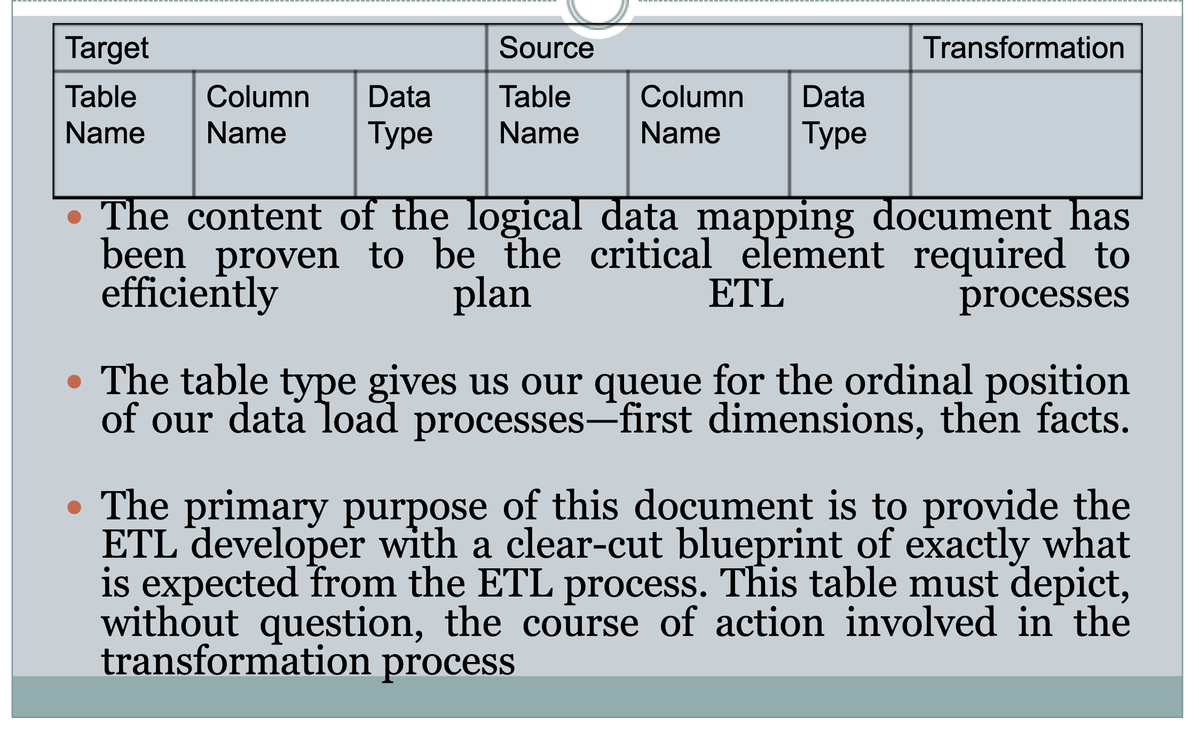
Using Tools for Logical Data Map

Slide 39
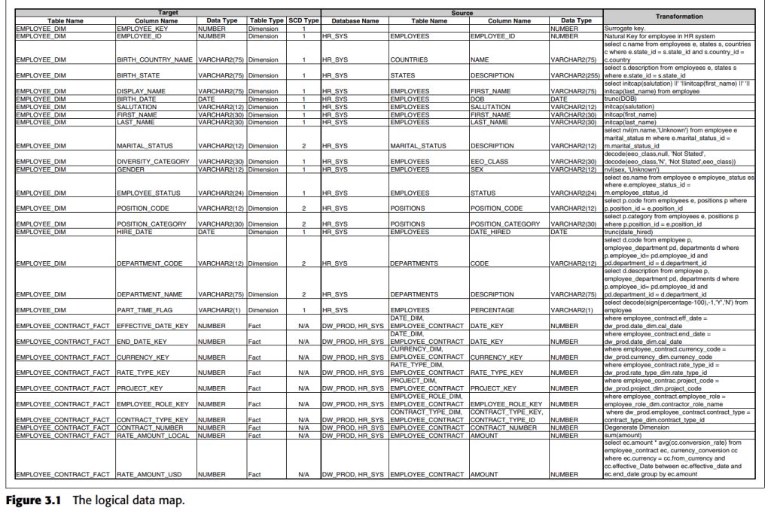

Slide 40


Slide 41
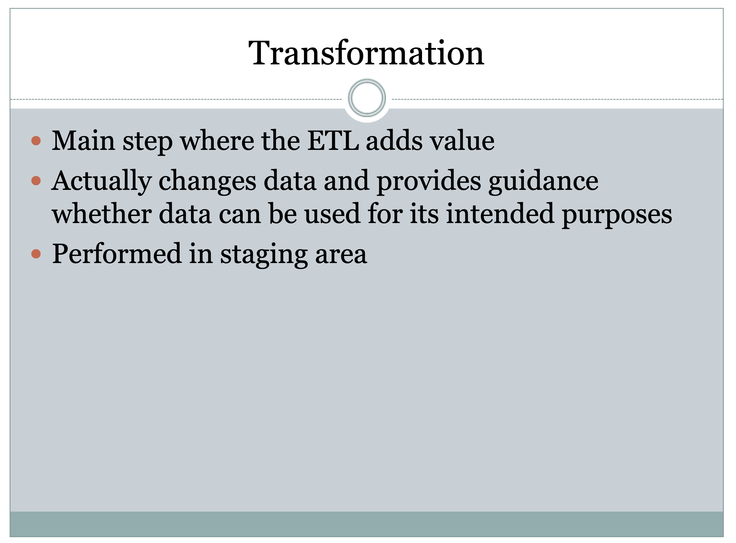

Slide 42
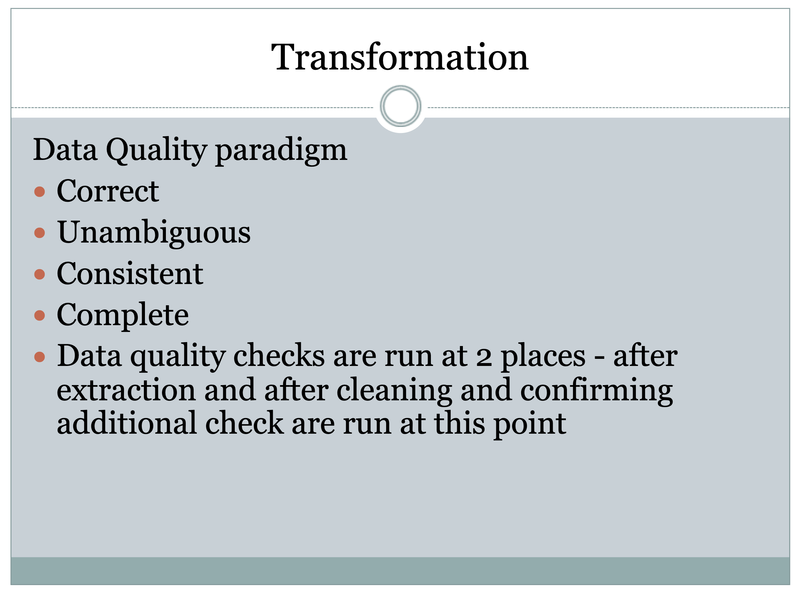

Slide 43
The Data Transformation Process
Once the data has been profiled, data mapping and transformation rules are defined to convert the data into a common format that can be easily analysed and interpreted.
Data quality checks are performed throughout the transformation process to ensure that the data is accurate, complete, and consistent. The transformed data is then loaded into a target system, such as a business intelligence tool, where it can be analysed and used to make decisions.

Slide 44
Types of data transformation that can be performed:
Data Cleaning
Data Formatting
Data Enrichment
Data Normalization
Data Scrubbing

Slide 45
1. Data Cleaning:
This involves identifying and correcting errors or inconsistencies in the data, such as missing or incorrect values, duplicates, or formatting issues.
Data cleaning is an important step in the data transformation process because it helps to ensure that the data is accurate and reliable.

Slide 46
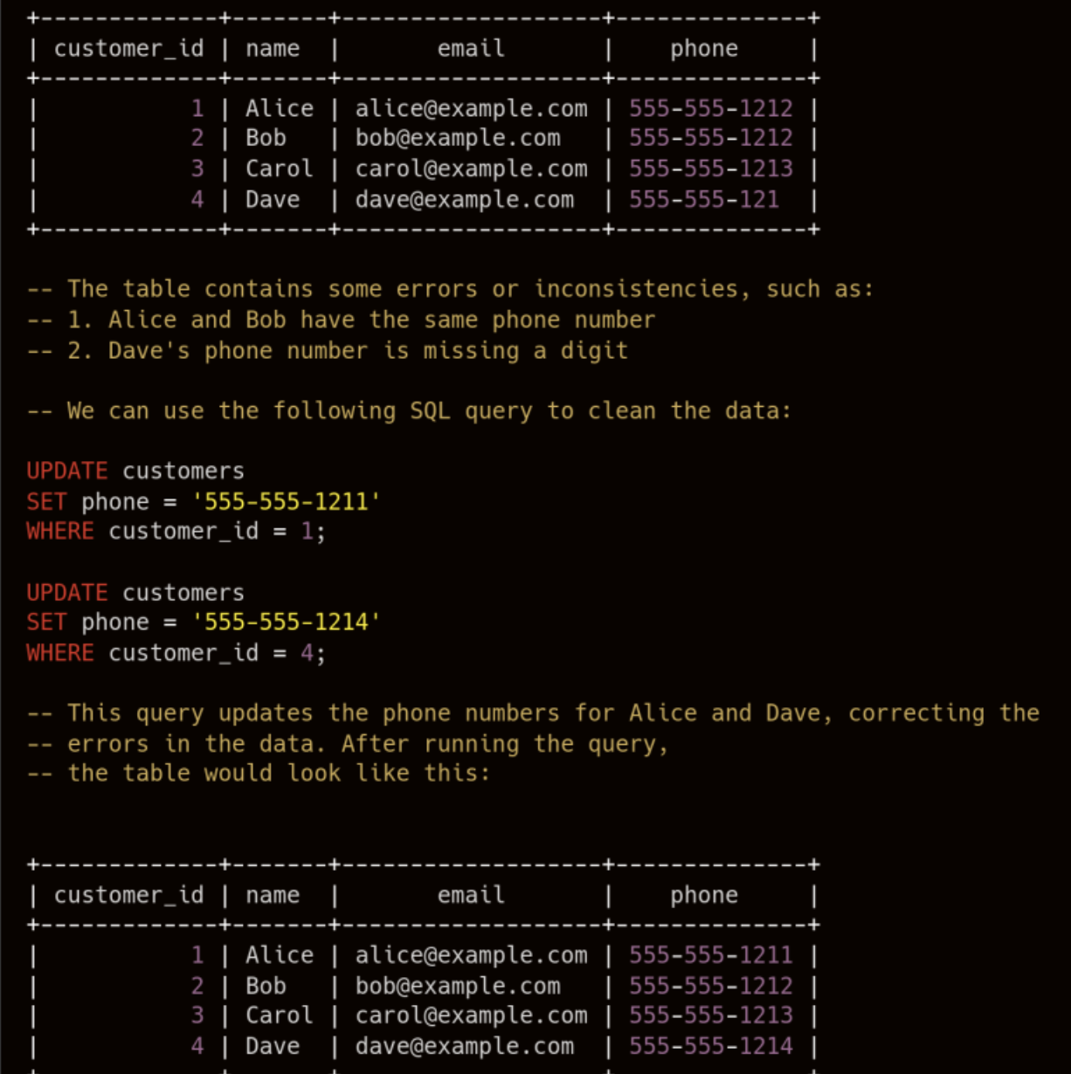

Slide 47
2. Data Formatting:
This involves changing the appearance or structure of the data in order to make it more consistent or suitable for a particular task.
For example, data might be formatted to conform to a specific date or time format or to use a consistent delimiter or separator.

Slide 48
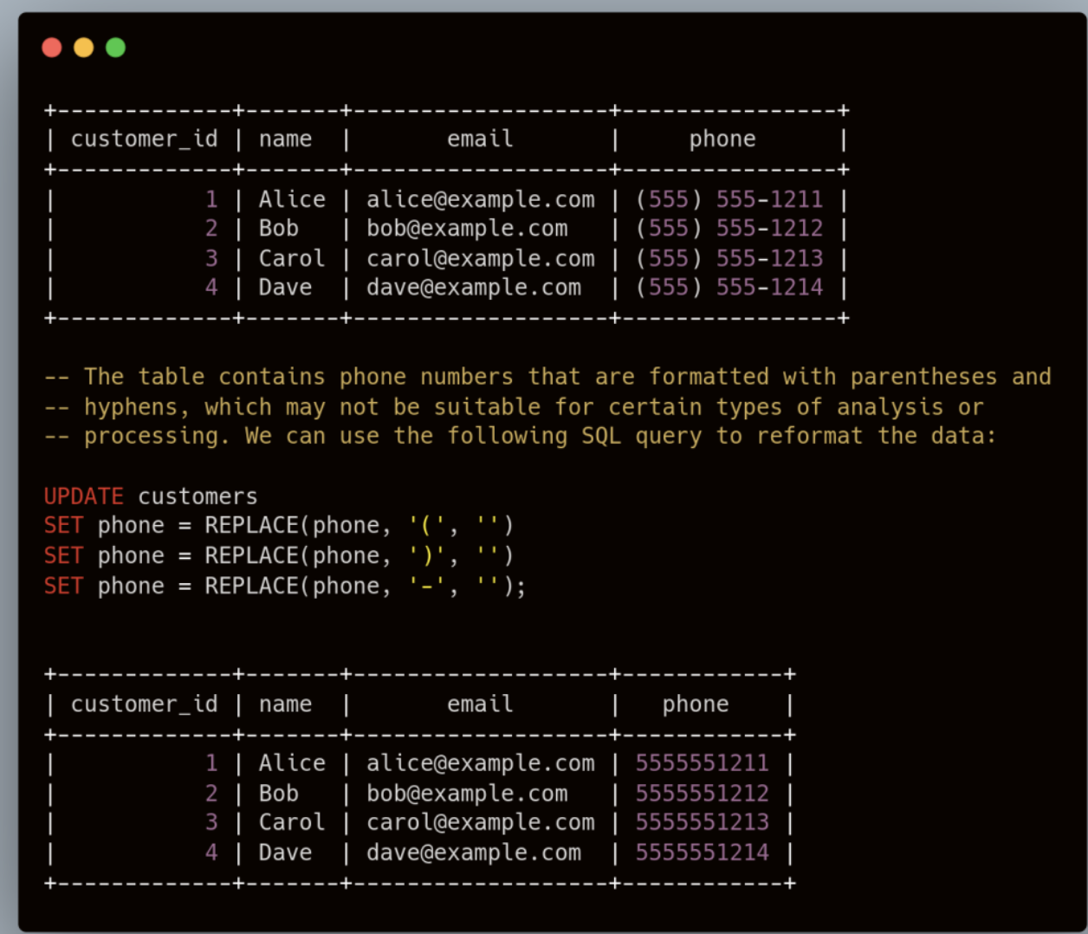

Slide 49
3. Data Enrichment:
This involves adding additional information or context to the data, in order to make it more valuable or useful.
This might involve linking the data to external sources of information, such as reference data or metadata, or adding derived variables or features based on the data.

Slide 50
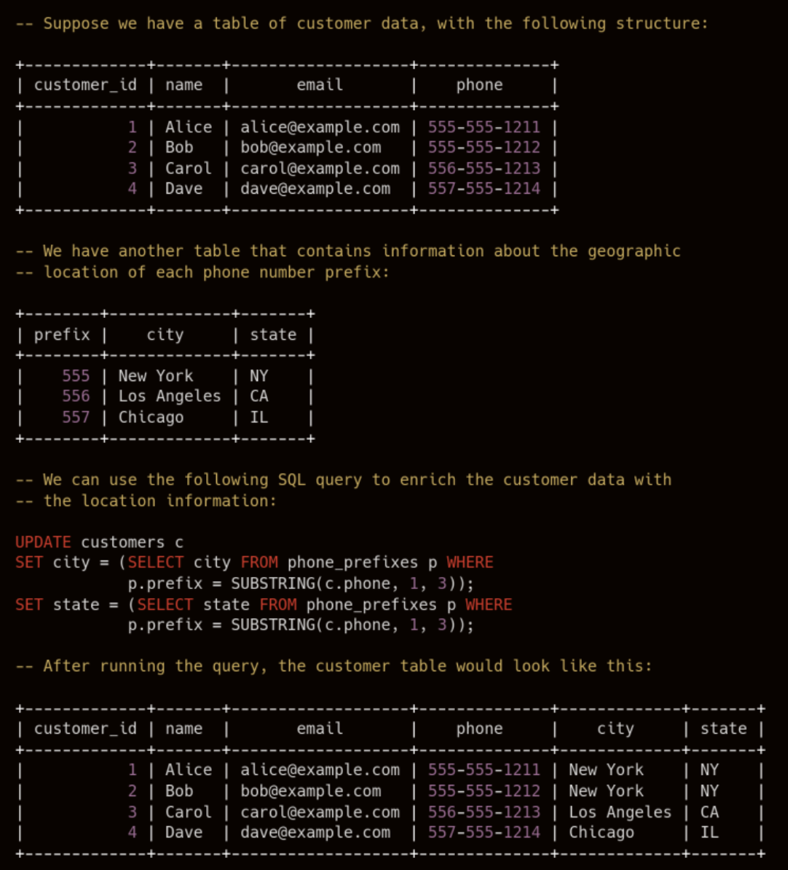

Slide 51
4. Data Normalization:
Data normalization is the process of organizing a database in a way that minimizes redundancy and dependency and maximizes data integrity. This is an important step in the data transformation process, as it helps to ensure that the data is stored in a consistent and efficient manner, and is less prone to errors or inconsistencies.

Slide 52
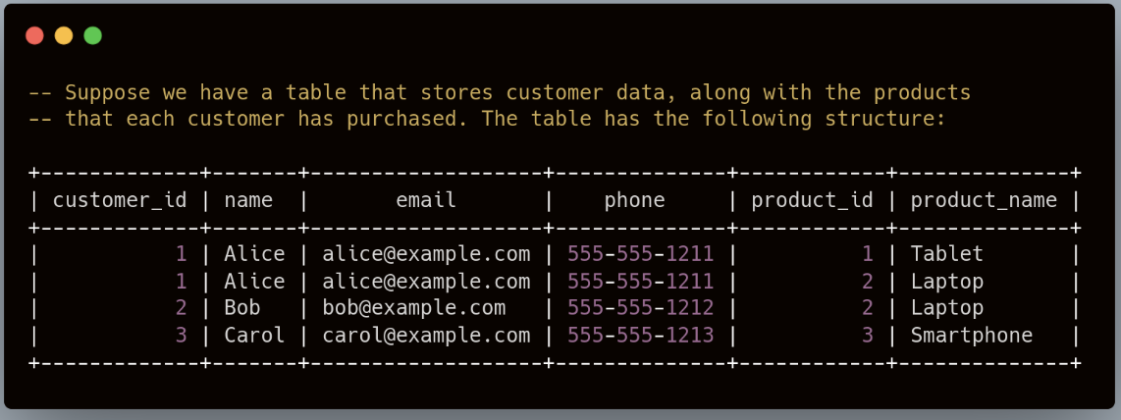

Slide 53
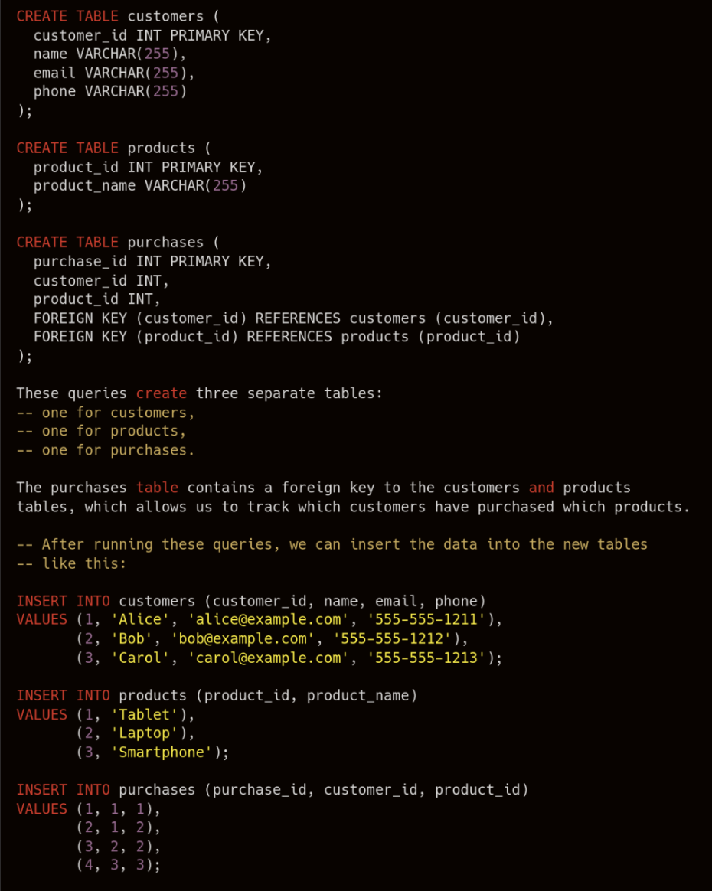

Slide 54
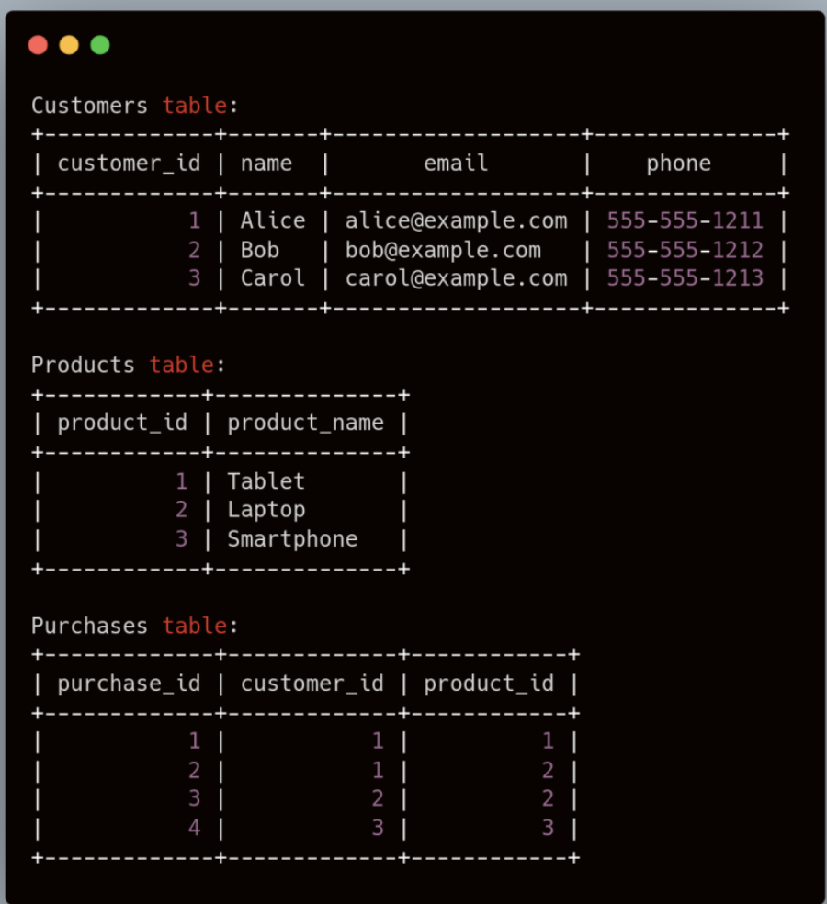

Slide 55
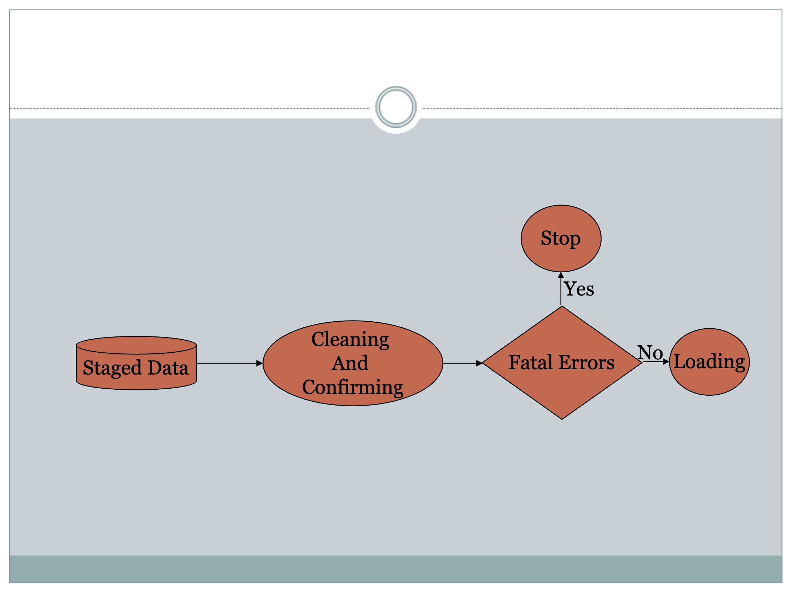

Slide 56


Slide 57
Two primary methods to load data into a warehouse
Full load:
With a full load, the entire dataset is dumped, or loaded, and is then completely replaced with the new, updated dataset.
No additional information, such as timestamps, is required.
For example, take a store that uploads all of its sales through the ETL process in data warehouse at the end of each day. Let’s say 5 sales were made on a Monday, so that on Monday night a table of 5 records would be uploaded. Then, on Tuesday, another 3 sales were made which need to be added. So on Tuesday night, assuming a full load, Monday’s 5 records as well as Tuesday’s 3 records are uploaded – an inefficient system, although relatively easy to set up and maintain.

Slide 58
Incremental load:
There are 2 types of incremental loads, depending on the volume of data you’re loading:
Streaming incremental load – better for loading small data volumes
Batch incremental load – better for loading large data volumes
Following the previous example, the store that made 3 sales on Tuesday will load only the additional 3 records to the sales table, instead of reloading all records. This has the advantage of saving time and resources, but increases complexity.

Slide 59
Incremental loading is of course much faster than a full load. The main drawback to this type of loading is maintainability. Unlike a full load, with an incremental load you can’t re-run the entire load if there’s an error.
In addition to this, files need to be loaded in order, so errors will compound the issue as other data queues up.

Slide 60
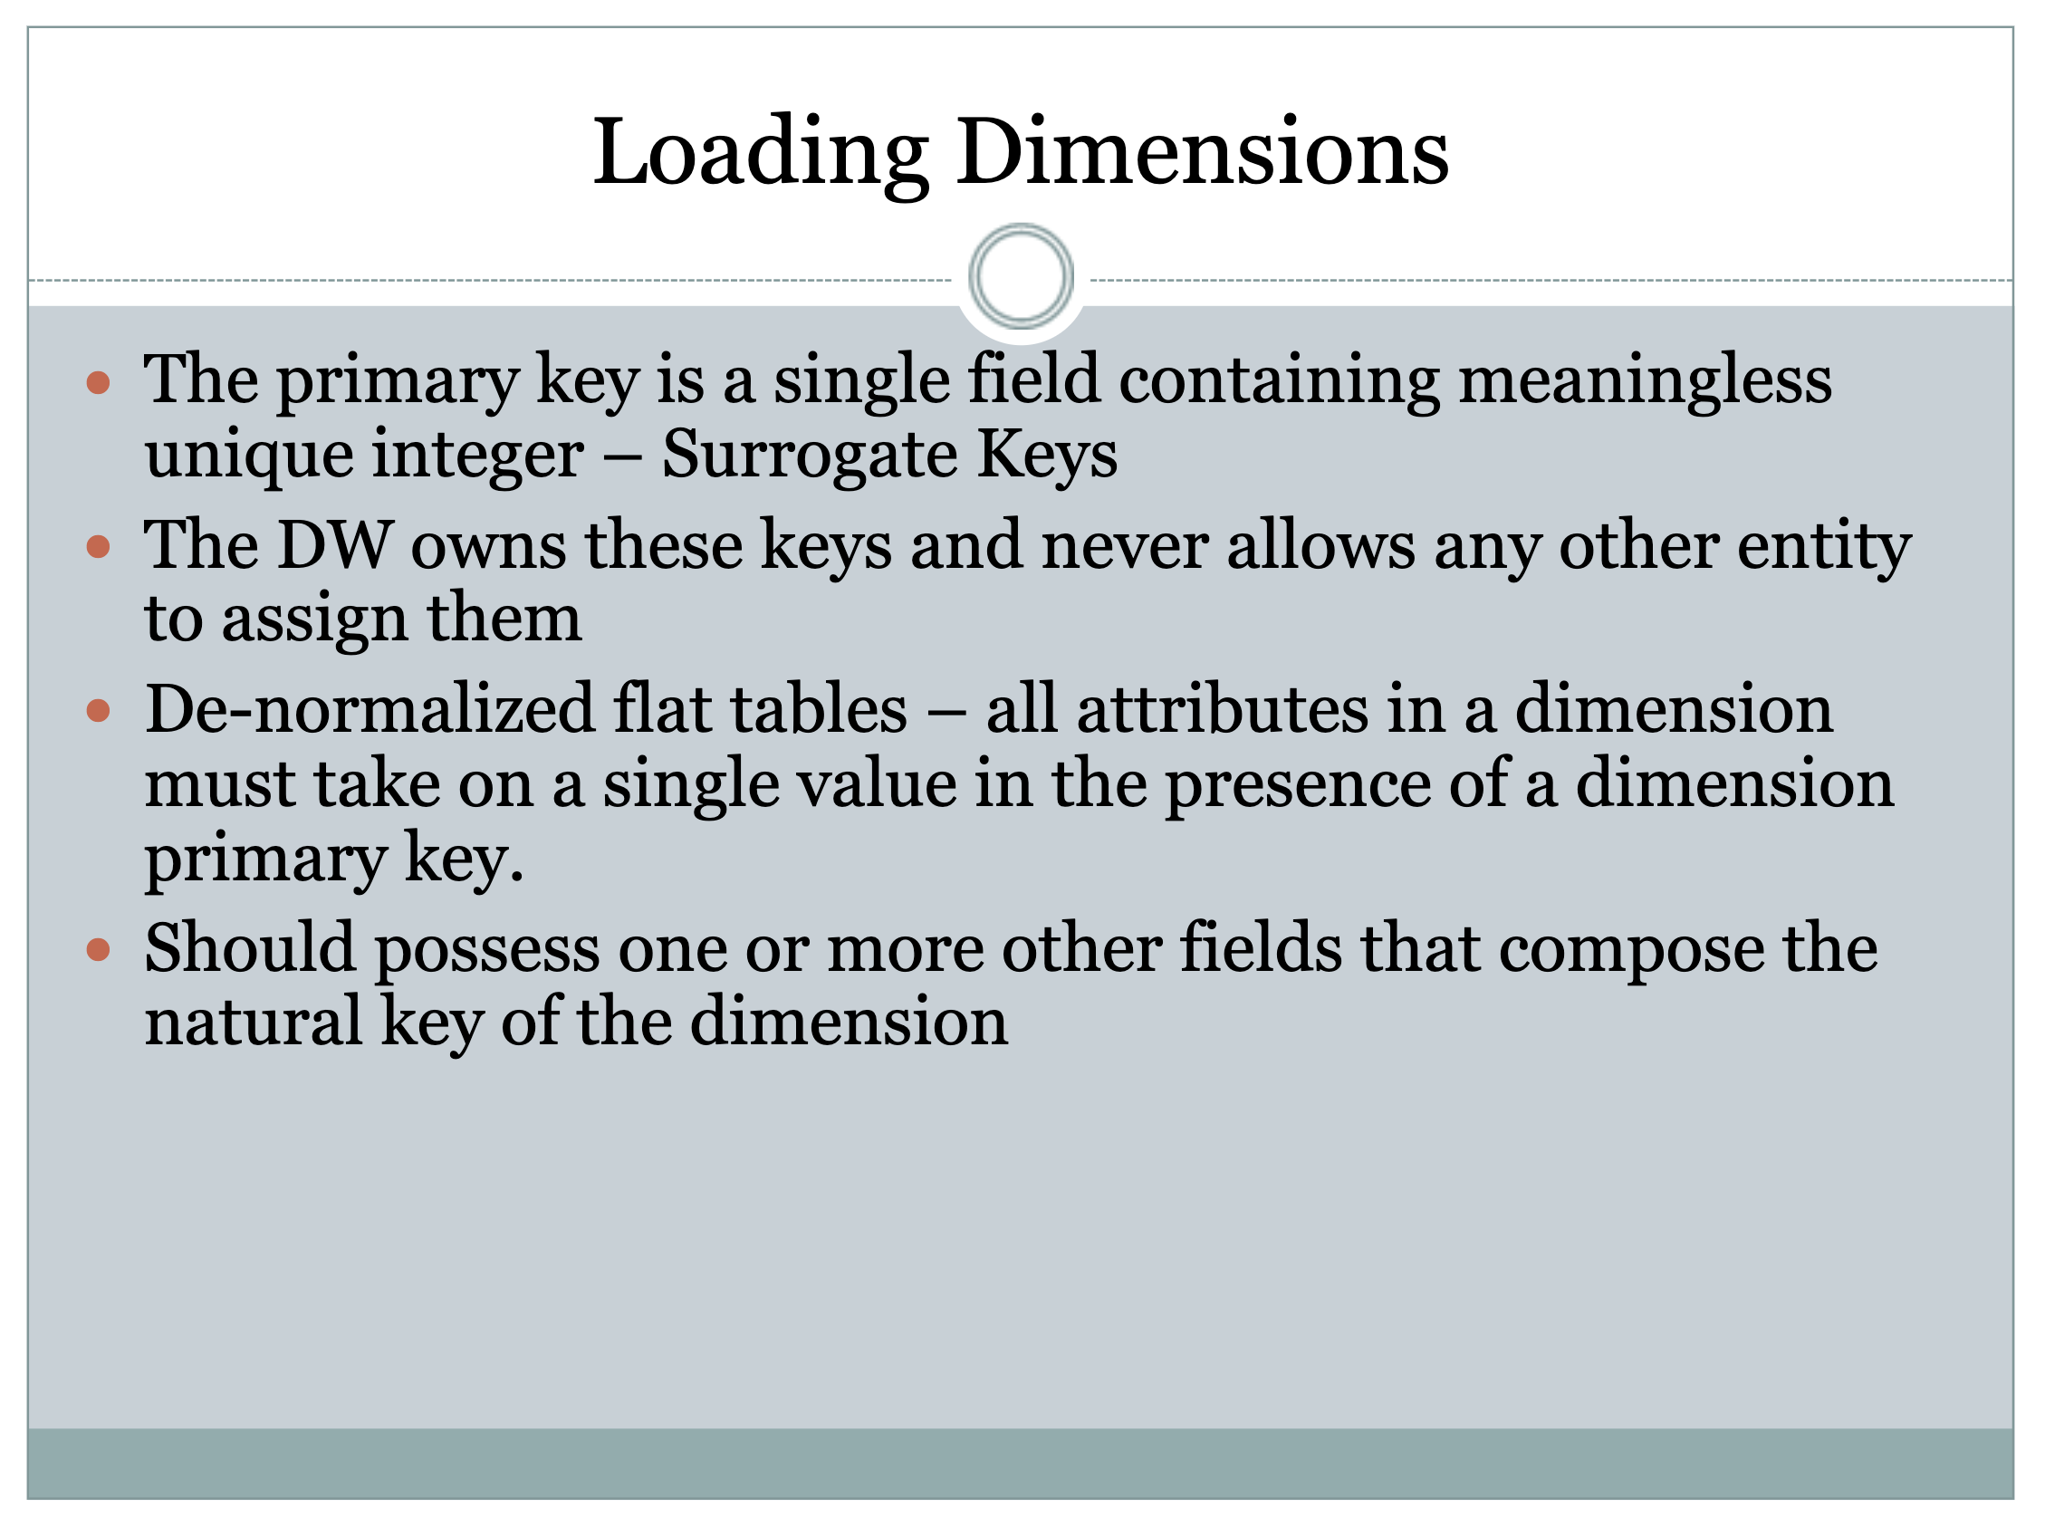

Slide 61
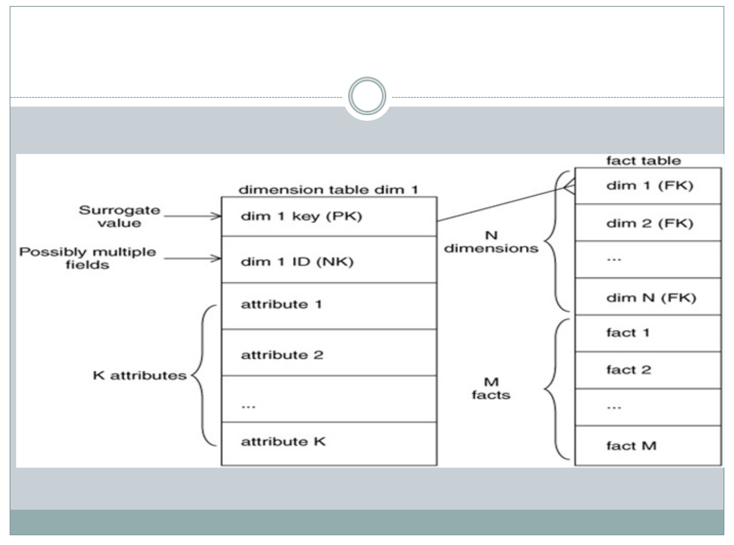

Slide 62
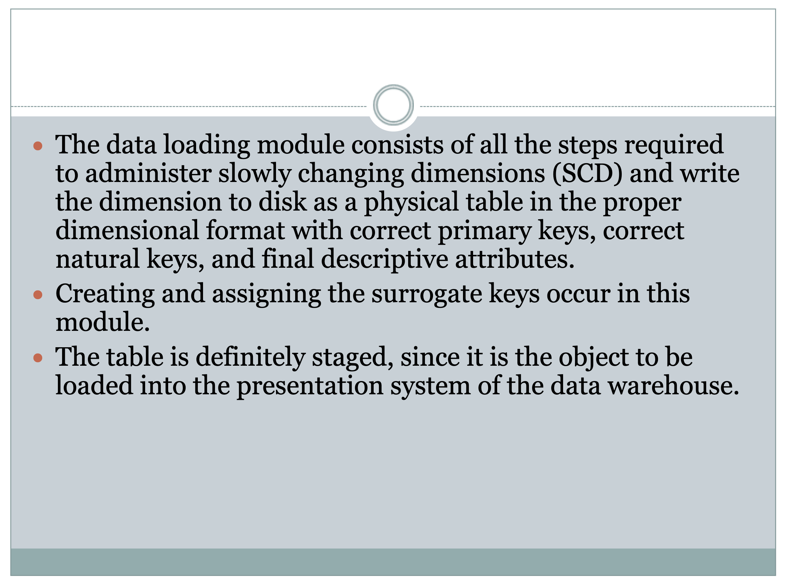

Slide 64
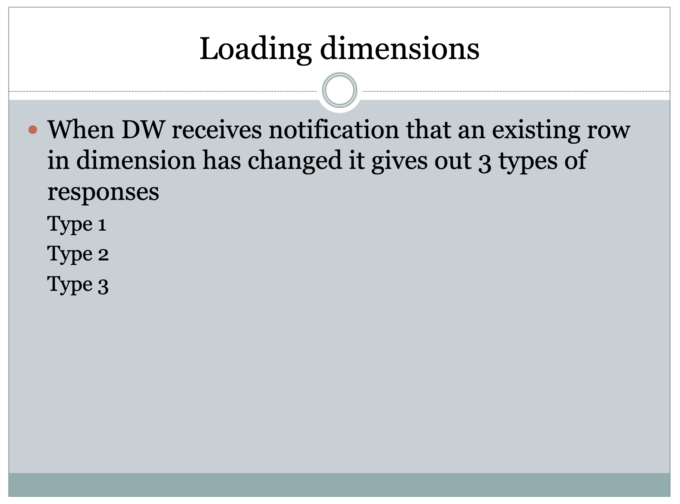

Slide 65
